Slide 1
Meeting Agenda
– August 4, 2021 –
1:00-1:30 pm
Welcome
Opening announcements
Chair updates
International – Yutian Feng & Stephen Jannetti
Professional Development – Corinne Haines & Susanna Brantley
International – Yutian Feng & Stephen Jannetti
Communications – Miranda Scalabrino & Neelam Makhijani
Service – Lauren Slosky & Jacques Stout
Outreach – Claudia Gonzalez-Hunt, Kathryn Walder, & Daniel Luo
Diversity – Marhiah Montoya
Questions and Discussion
Closing

Slide 2
Meeting Agenda
– August 4, 2021 –
1:00-1:30 pm
Welcome
Opening announcements
Chair updates
International – Yutian Feng & Stephen Jannetti
Professional Development – Corinne Haines & Susanna Brantley
International – Yutian Feng & Stephen Jannetti
Communications – Miranda Scalabrino & Neelam Makhijani
Service – Lauren Slosky & Jacques Stout
Outreach – Claudia Gonzalez-Hunt, Kathryn Walder, & Daniel Luo
Diversity – Marhiah Montoya
Questions and Discussion
Closing

Slide 3
Meeting Agenda
– August 4, 2021 –
1:00-1:30 pm
Welcome
Opening announcements
Chair updates
International – Yutian Feng & Stephen Jannetti
Professional Development – Corinne Haines & Susanna Brantley
International – Yutian Feng & Stephen Jannetti
Communications – Miranda Scalabrino & Neelam Makhijani
Service – Lauren Slosky & Jacques Stout
Outreach – Claudia Gonzalez-Hunt, Kathryn Walder, & Daniel Luo
Diversity – Marhiah Montoya
Questions and Discussion
Closing

Slide 4
Meeting Agenda
– August 4, 2021 –
1:00-1:30 pm
Welcome
Opening announcements
Chair updates
International – Yutian Feng & Stephen Jannetti
Professional Development – Corinne Haines & Susanna Brantley
Social – Leanna Ross & Katherine Collins
Communications – Miranda Scalabrino & Neelam Makhijani
Service – Lauren Slosky & Jacques Stout
Outreach – Claudia Gonzalez-Hunt, Kathryn Walder, & Daniel Luo
Diversity – Marhiah Montoya
Questions and Discussion
Closing

Slide 5
Updates from International Chairs
International Co-chairs: Yutian Feng and Stephen Jannetti
Tour to the Duke Lemur Center
Pick up soccer games
Ultimate Frisbee/Disc Golf
Free online seminars about VISA/green cards (?)
Duke buddy program --- P2P program

Slide 6
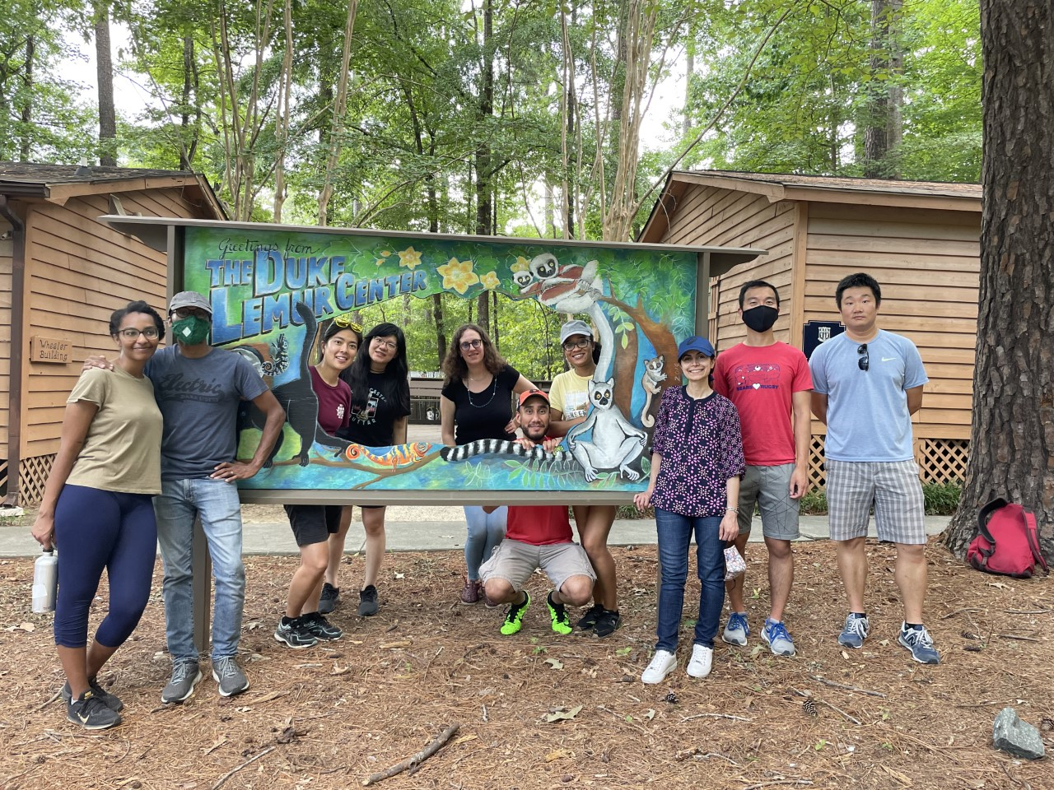
Duke Lemur Center is the only place outside Madagascar where you can see this many lemurs
More tours needed?

Slide 7
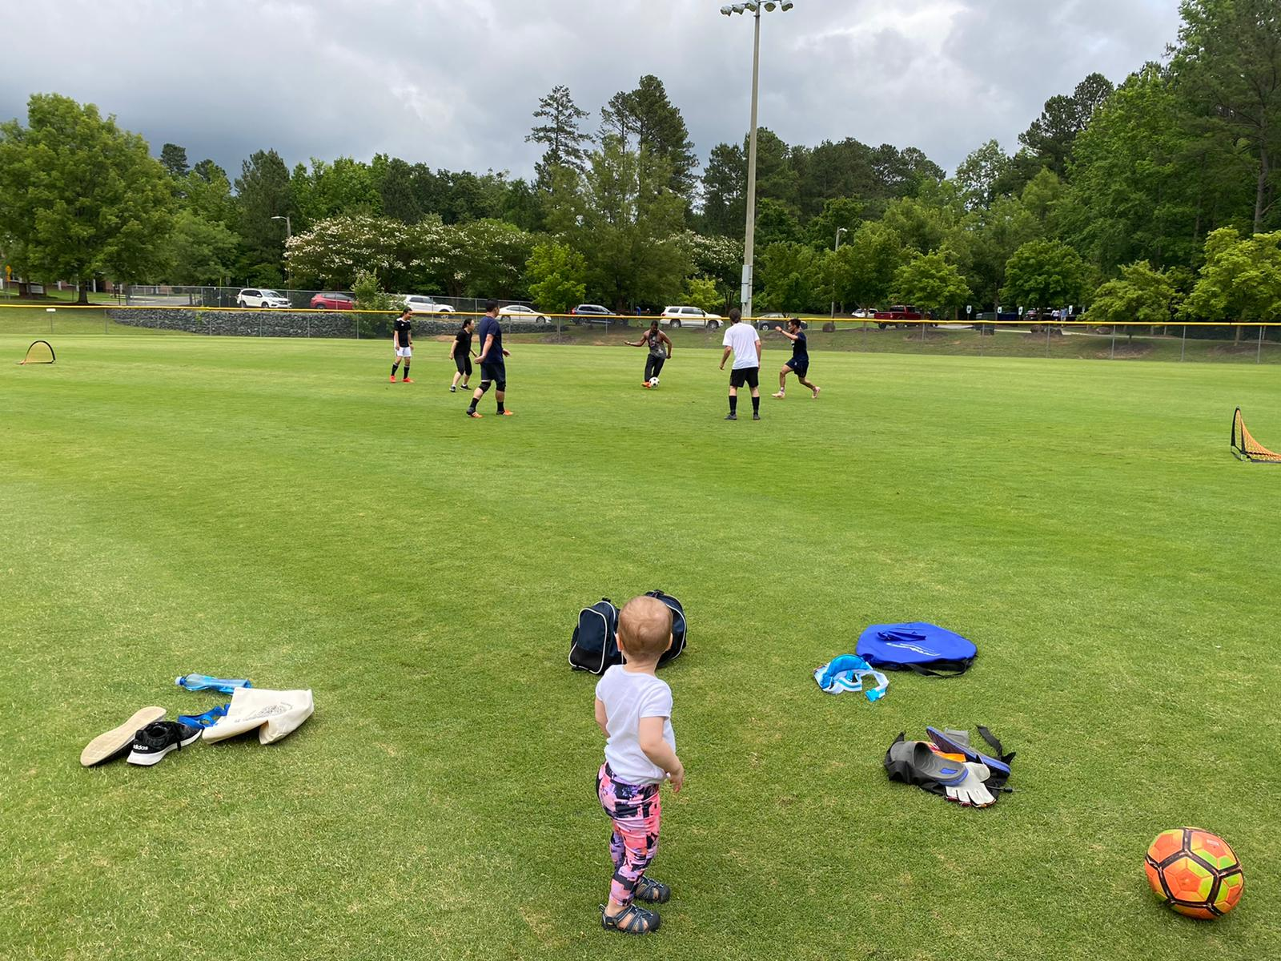
Weekly pick up soccer game for vaccinated people only. We have ~15 players for each game now.
Family friendly!!
Contact Yutian (yutian.feng@duke.edu) if interested.

Slide 8
Ultimate Frisbee: more participants needed!
Free online seminars about VISA/green cards: any interests?
Duke buddy program --- P2P program

Slide 9
Meeting Agenda
– August 4, 2021 –
1:00-1:30 pm
Welcome
Opening announcements
Chair updates
International – Yutian Feng & Stephen Jannetti
Professional Development – Corinne Haines & Susanna Brantley
Social – Leanna Ross & Katherine Collins
Communications – Miranda Scalabrino & Neelam Makhijani
Service – Lauren Slosky & Jacques Stout
Outreach – Claudia Gonzalez-Hunt, Kathryn Walder, & Daniel Luo
Diversity – Marhiah Montoya
Questions and Discussion
Closing

Slide 10
Professional Development
Co-chairs: Corinne Haines and Susanna Brantley

Slide 11
Meeting Agenda
– August 4, 2021 –
1:00-1:30 pm
Welcome
Opening announcements
Chair updates
International – Yutian Feng & Stephen Jannetti
Professional Development – Corinne Haines & Susanna Brantley
Social – Leanna Ross & Katherine Collins
Communications – Miranda Scalabrino & Neelam Makhijani
Service – Lauren Slosky & Jacques Stout
Outreach – Claudia Gonzalez-Hunt, Kathryn Walder, & Daniel Luo
Diversity – Marhiah Montoya
Questions and Discussion
Closing

Slide 12
Virtual Event Update:
Unfortunately, not a lot of people are attending virtual trivia + happy hour, so we will not hold another virtual event for now.
In-Person Event Update:
We were hoping for an in-person meet-up, but given the heightened restrictions due to the delta variant, we should probably hold off. ☹
Any other ideas?

Slide 13
Meeting Agenda
– August 4, 2021 –
1:00-1:30 pm
Welcome
Opening announcements
Chair updates
International – Yutian Feng & Stephen Jannetti
Professional Development – Corinne Haines & Susanna Brantley
International – Yutian Feng & Stephen Jannetti
Communications – Miranda Scalabrino & Neelam Makhijani
Service – Lauren Slosky & Jacques Stout
Outreach – Claudia Gonzalez-Hunt, Kathryn Walder, & Daniel Luo
Diversity – Marhiah Montoya
Questions and Discussion
Closing

Slide 14
Communications
Miranda.Scalabrino@duke.edu or neelam.makhijani@duke.edu
Accepting nominations to highlight postdocs and/or their research and accomplishments on Twitter & Instagram (@DukePostdocs)
You can nominate yourself!
Email me events to highlight

Slide 15
Meeting Agenda
– August 4, 2021 –
1:00-1:30 pm
Welcome
Opening announcements
Chair updates
International – Yutian Feng & Stephen Jannetti
Professional Development – Corinne Haines & Susanna Brantley
Social – Leanna Ross & Katherine Collins
Communications – Miranda Scalabrino & Neelam Makhijani
Service – Lauren Slosky & Jacques Stout
Outreach – Claudia Gonzalez-Hunt, Kathryn Walder, & Daniel Luo
Diversity – Marhiah Montoya
Questions and Discussion
Closing

Slide 16
Meeting Agenda
– August 4, 2021 –
1:00-1:30 pm
Welcome
Opening announcements
Chair updates
International – Yutian Feng & Stephen Jannetti
Professional Development – Corinne Haines & Susanna Brantley
Social – Leanna Ross & Katherine Collins
Communications – Miranda Scalabrino & Neelam Makhijani
Service – Lauren Slosky & Jacques Stout
Outreach – Claudia Gonzalez-Hunt, Kathryn Walder, & Daniel Luo
Diversity – Marhiah Montoya
Questions and Discussion
Closing
Notes:
Our update was that we talked to Miranda and she gave us the information for the twitter account and are planning on reaching out to postdocs this semester to showcase their research via social media! I was thinking, could we have a blog on the DUPA website? And postdocs submit outreach content that we can screen/approve and post? Could be on their own research, or other topics like vaccine safety etc.?

Slide 17
Outreach
Riverside High School Event
Admins wanted to connect closer to the Fall semester, said they would reach out but haven’t yet.
Durham Tech
Career services director interested in partnering. Said she wanted to connect once they were back working in person. Haven’t heard from her since June, not sure if they’re still working from home?
Will reach out to both again!

Slide 18
Meeting Agenda
– August 4, 2021 –
1:00-1:30 pm
Welcome
Opening announcements
Chair updates
International – Yutian Feng & Stephen Jannetti
Professional Development – Corinne Haines & Susanna Brantley
International – Yutian Feng & Stephen Jannetti
Communications – Miranda Scalabrino & Neelam Makhijani
Service – Lauren Slosky & Jacques Stout
Outreach – Claudia Gonzalez-Hunt, Kathryn Walder, & Daniel Luo
Diversity – Marhiah Montoya
Questions and Discussion
Closing

Slide 19
Meeting Agenda
– August 4, 2021 –
1:00-1:30 pm
Welcome
Opening announcements
Chair updates
International – Yutian Feng & Stephen Jannetti
Professional Development – Corinne Haines & Susanna Brantley
Social – Leanna Ross & Katherine Collins
Communications – Miranda Scalabrino & Neelam Makhijani
Service – Lauren Slosky & Jacques Stout
Outreach – Claudia Gonzalez-Hunt, Kathryn Walder, & Daniel Luo
Diversity – Marhiah Montoya
Questions and Discussion
Closing

Slide 20
Meeting Agenda
– August 4, 2021 –
1:00-1:30 pm
Welcome
Opening announcements
Chair updates
International – Yutian Feng & Stephen Jannetti
Professional Development – Corinne Haines & Susanna Brantley
Social – Leanna Ross & Katherine Collins
Communications – Miranda Scalabrino & Neelam Makhijani
Service – Lauren Slosky & Jacques Stout
Outreach – Claudia Gonzalez-Hunt, Kathryn Walder, & Daniel Luo
Diversity – Marhiah Montoya
Questions and Discussion
Closing

Slide 21
Next DUPA meeting
– September 1, 2021 –
1:00-1:30 pm

