Slide 1

Meeting Agenda
October 6, 2021
Welcome
Opening announcements
Chair updates
  Communications – Miranda Scalabrino & OPEN
  Diversity – Marhiah Montoya & OPEN
  International – Yutian Feng, Dilimini Wijesinghe, Thomas Pomberger, Atefah (Aty) Ghazavi, Weijia Su
  Outreach – Claudia Gonzalez-Hunt & Daniel Luo
  Professional Development – Susanna Brantley & Corinne Haines
  Service – Jacques Stout & OPEN
  Social – OPEN!
New council member election
Questions and Discussion
Closing
Notes:
Welcome to all the new faces! Nice to see the old ones as well. Theres quite a few ppl that responded to our call to get more involvement. We are happy to have you and thank you for being here!

Slide 2
Meeting Agenda
October 6, 2021
Welcome
Opening announcements
Chair updates
  Communications – Miranda Scalabrino & OPEN
  Diversity – Marhiah Montoya & OPEN
  International – Yutian Feng, Dilimini Wijesinghe, Thomas Pomberger, Atefah (Aty) Ghazavi, Weijia Su
  Outreach – Claudia Gonzalez-Hunt & Daniel Luo
  Professional Development – Susanna Brantley & Corinne Haines
  Service – Jacques Stout & OPEN
  Social – OPEN!
New council member election
Questions and Discussion
Closing
Notes:
Council met last week to discuss some changes we want to make to improve DUPA in order to better serve the postdoc community. Each committee defined their duties and goals. Some info sent in the monthly meeting email and is included in the slides today. We hope to recruit more postdocs from diverse backgrounds and interests, in order to best serve our community. On today’s agenda are updates from each of the committees and we can elect in new council members at the end if they’ve attended 2+ meetings. And then we will open the floor to questions and discussion. So with that, let’s jump into updates from our committee chairs!

Slide 3
Meeting Agenda
October 6, 2021
Welcome
Opening announcements
Chair updates
  Communications – Miranda Scalabrino & OPEN
  Diversity – Marhiah Montoya & OPEN
  International – Yutian Feng, Dilimini Wijesinghe, Thomas Pomberger, Atefah (Aty) Ghazavi, Weijia Su
  Outreach – Claudia Gonzalez-Hunt & Daniel Luo
  Professional Development – Susanna Brantley & Corinne Haines
  Service – Jacques Stout & OPEN
  Social – OPEN!
New council member election
Questions and Discussion
Closing

Slide 4
Communications
Miranda Scalabrino
Miranda.scalabrino@duke.edu
Communications Committee Duties:
The communications team is responsible for taking and distributing meeting notes, updating the website, and posting events/relevant information on Duke Postdoc social media. Goal is to spotlight 1 postdoc per month on social media. Meeting minutes should be posted & emailed to listserv within 48h of the meeting.
Updates:
New slack group! Will send invite to postdoc listserv
LinkedIn
Looking for co-chair(s)!
Notes:
Goals of the committee:
1. Give postdocs a forum to present their research to general audiences and help amplify the impact of their work.
2. Reach out to K-12 and college students and familiarize them with graduate school and a career in research by presenting our work and telling our stories.
3. Engage with our local communities and find ways to more effectively disseminate our work and collaborate for their benefit.

Slide 5
Meeting Agenda
October 6, 2021
Welcome
Opening announcements
Chair updates
  Communications – Miranda Scalabrino & OPEN
  Diversity – Marhiah Montoya & OPEN
  International – Yutian Feng, Dilimini Wijesinghe, Thomas Pomberger, Atefah (Aty) Ghazavi, Weijia Su
  Outreach – Claudia Gonzalez-Hunt & Daniel Luo
  Professional Development – Susanna Brantley & Corinne Haines
  Service – Jacques Stout & OPEN
  Social – OPEN!
New council member election
Questions and Discussion
Closing

Slide 6
Diversity
Marhiah Montoya
Marhiah.Montoya@duke.edu
Diversity Chair Discussion Topics:
Postdoctoral Working Conditions and DEI Climate Survey was updated based on postdoc feedback and feedback from the DUPA International Postdoc Committee and will be finalized this month for formal distribution by January 1st 2022.
Monthly Events:
  10/26 at 6pm – Whine & Cheese – Monthly Postdoc Virtual Gathering to vent (or whine) about ANYTHING, cheese is optional. If you’re wondering what this gathering might be like, check out this YouTube video https://www.youtube.com/watch?v=Nvhh6ciMmJU
Zoom Link: https://duke.zoom.us/j/97088229772?pwd=dWh4QndnMUUzdkl2U21ldFdYTDk1QT09
Meeting ID: 970 8822 9772 Passcode: 773391
  10/27 - PUSHED (Postdocs Uniting Science & Healthcare to Eliminate Disparities in Research) virtual gathering!
PUSHED is a Monthly Zoom Brainstorming /“Think-Tank” type meeting (every 4th Wednesday) where postdocs gather to discuss ways to integrate health disparities into their research and informally discuss their research findings that relate to health disparities. If you’re struggling with trying to find ways to connect your research with racial and ethnic health disparities, this group is for you!
Zoom Link: https://duke.zoom.us/j/94141425852?pwd=RUVZYXdiVFhlRlpnUG82OUZxNm85Zz09
Meeting ID: 941 4142 5852 Passcode: 374153
Proposal for a new collaborative project between Diversity and International Committee as well as any postdoc that wishes to help:
  Welcome Packet and Information for International Postdocs – To include information and contacts to help with finding housing, setting up US federal documents such as social security, drivers license, credit cards, etc., in-city transportation, how to navigate the triangle area for basic needs, health care, and entertainment, and so much more. WE NEED YOUR IDEAS! Reference/Template: international_postdoc_surviv.pdf (ymaws.com)
  Duke Visa Policy – It has been brought to my attention that international postdocs are not treated the same in regards to the types of visas granted to them. There are differences by departments for postdocs with the same funding. We need to find out departmental policies and hear from international postdocs about their experiences with visas here at Duke. I would like to use this information to advocate for equal treatment of all international postdocs with the goal of reducing the burden of annual visa renewals for international postdocs that plan to continue research in their lab for more than a year as well as the visa issues that interfere with attending international conferences.
Notes:
Goals of the committee:
1. Give postdocs a forum to present their research to general audiences and help amplify the impact of their work.
2. Reach out to K-12 and college students and familiarize them with graduate school and a career in research by presenting our work and telling our stories.
3. Engage with our local communities and find ways to more effectively disseminate our work and collaborate for their benefit.

Slide 7
Meeting Agenda
October 6, 2021
Welcome
Opening announcements
Chair updates
  Communications – Miranda Scalabrino & OPEN
  Diversity – Marhiah Montoya & OPEN
  International – Yutian Feng, Dilimini Wijesinghe, Thomas Pomberger, Atefah (Aty) Ghazavi, Weijia Su
  Outreach – Claudia Gonzalez-Hunt & Daniel Luo
  Professional Development – Susanna Brantley & Corinne Haines
  Service – Jacques Stout & OPEN
  Social – OPEN!
New council member election
Questions and Discussion
Closing

Slide 8
DUPA
Immigration and visa seminar
Buddy Program
Current Members
International Committee
We need new members!

Slide 9
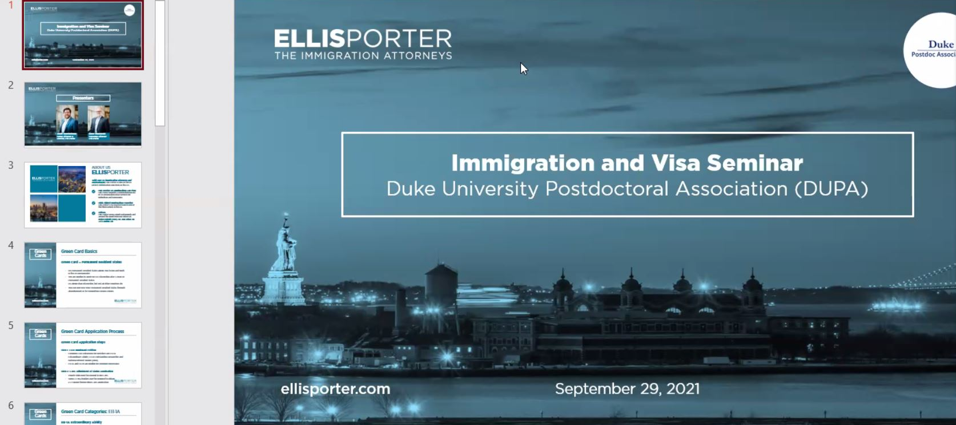
Immigration and Visa Seminar
Sept 29, 2021 via Zoom.
Invitation to triangle international postdocs.
65 participants.
Requests to conduct Immigration & visa seminar at least once in 3 to 6 months.
We will invite different law firms for future seminar.

Slide 10
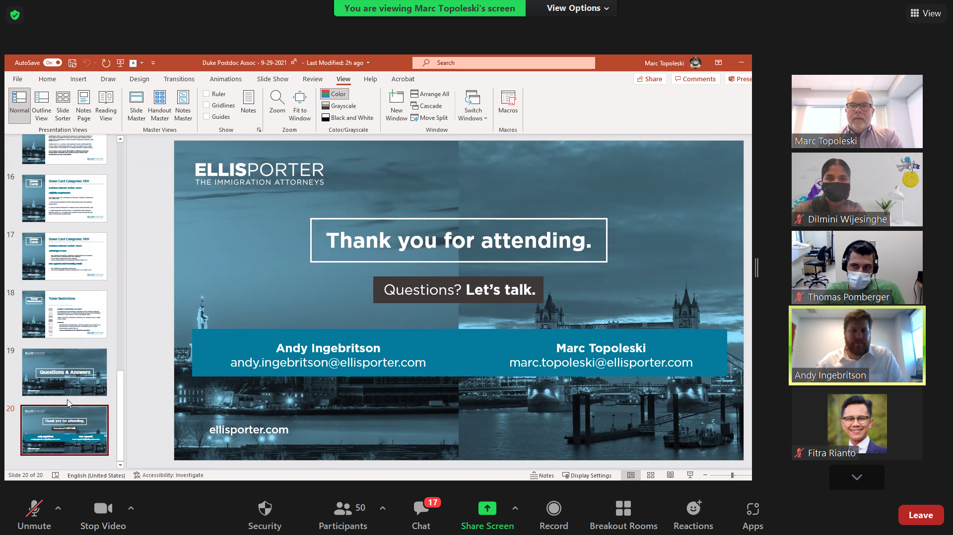
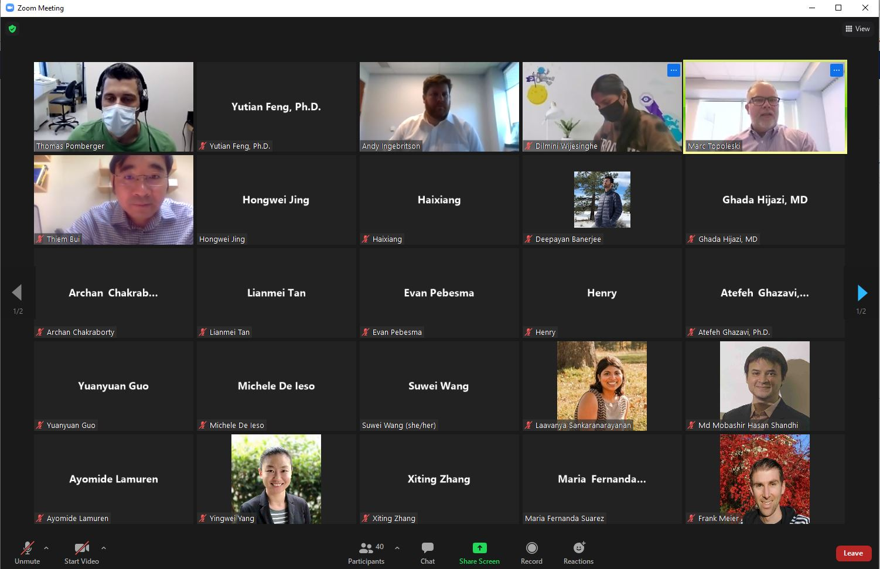
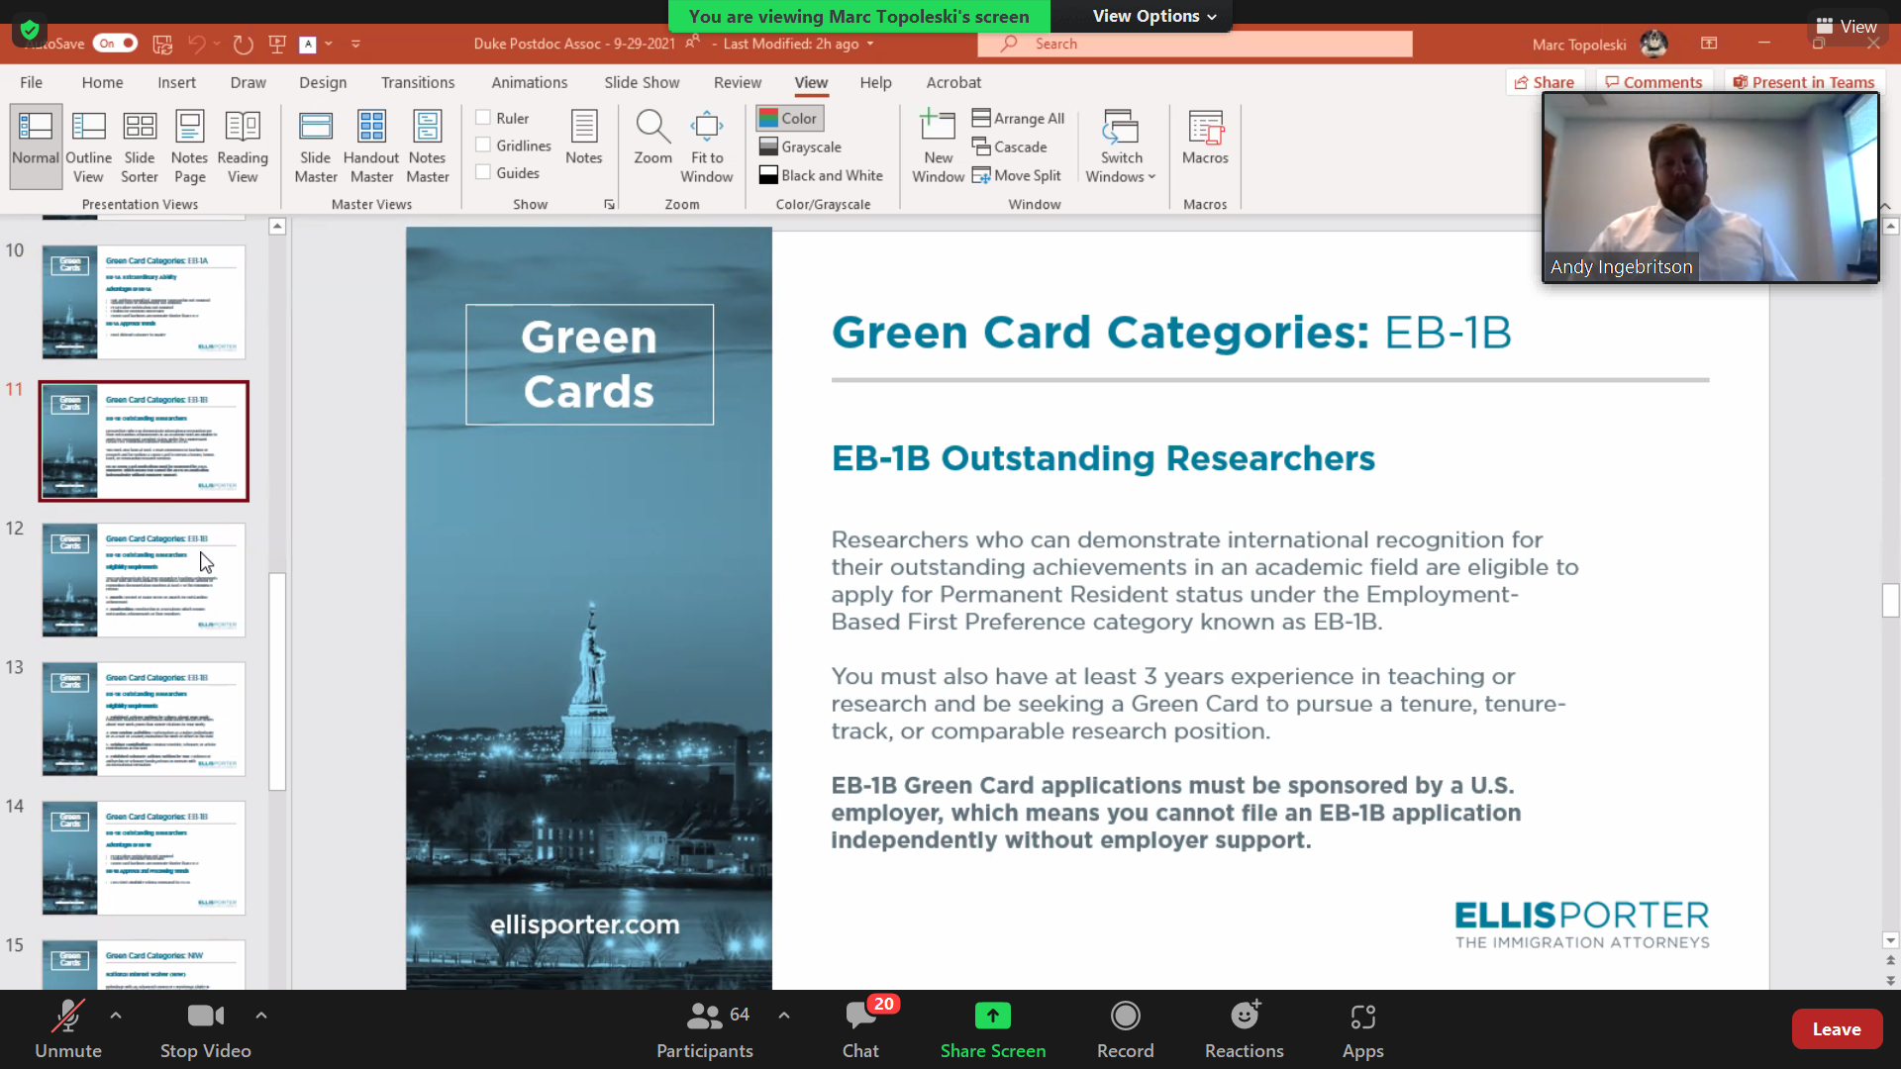
Immigration & Visa Seminar

Slide 11
Buddy Program
More than 130 Duke postdocs have signed up!
New surveys
  Feedback survey
  Modified Duke Buddy program Questionnaire
Interests outside work, Department, Nationality
Forming interest groups (hiking group, soccer team, basketball team, ultimate Frisbee team, potluck groups, running club, comedy club, etc.)

Slide 12
Upcoming Projects and Events
Duke Postdocs presents: Thanksgiving special comedy showcase: Gee, thanks Covid!
Fall hiking trips

Slide 13
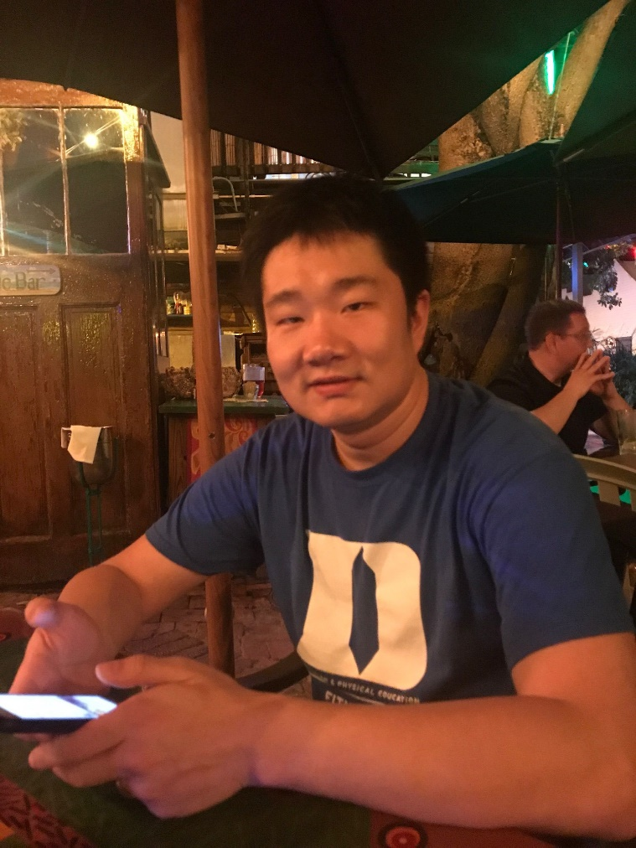
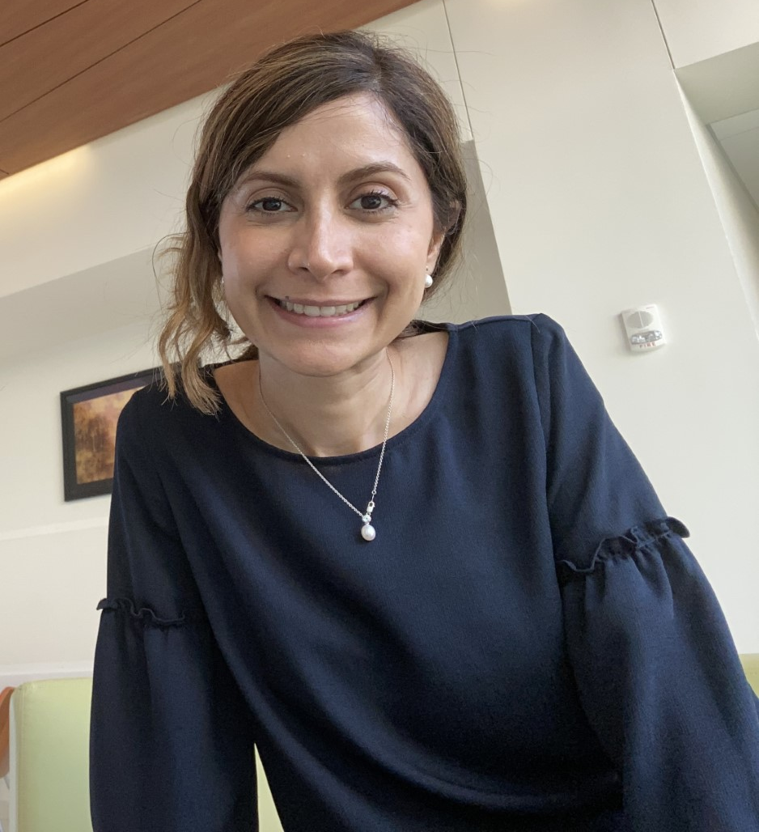
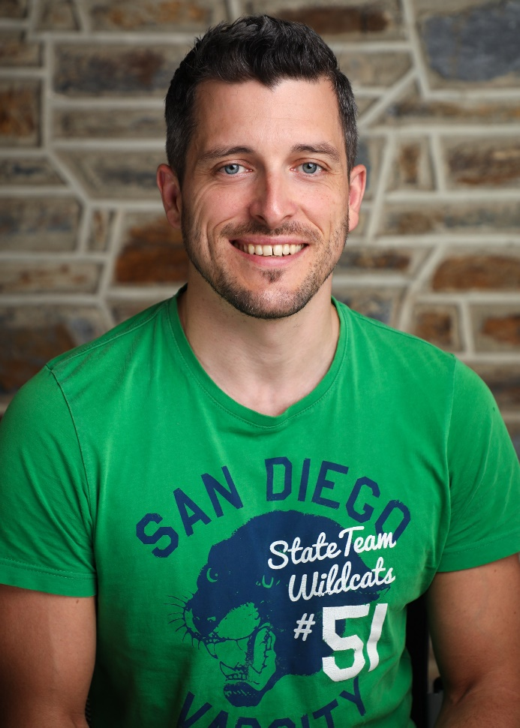
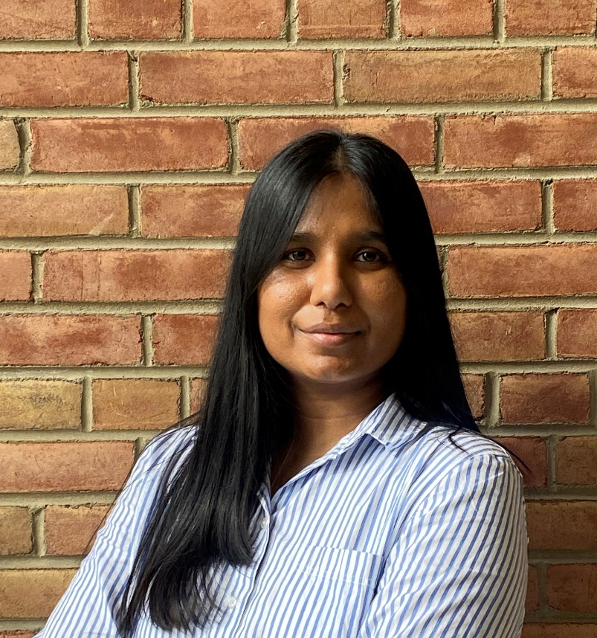
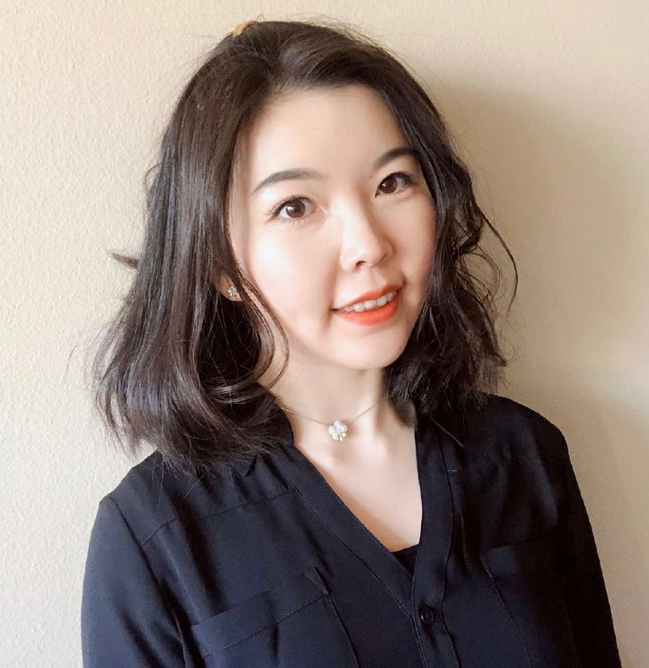
Current Members
Yutian Feng
(Yutian)
yutian.feng@duke.edu
Thomas Pomberger
(Thomas)
thomas.pomberger@duke.edu
Atefeh Ghazavi (Aty)
Atefeh.ghazavi@duke.edu
Dilmini Wijesinghe
(Dilmini)
k.wijesinghe@duke.edu
Weijia Su
(Weijia)
weijia.su@duke.edu

Slide 14
We need new members!!
DUPA International Committee
Our mission: we represent and advocate for international postdocs at Duke.
What we do: we organize fun events for international postdocs and their families (potluck, picnic, game night, local tours, hiking trips, etc.), and help international postdocs navigate their life and work at Duke.
What we expect of new members: an hour or 2 per week of your free time to help us produce better events!
International postdocs make up more than half of postdocs at Duke, so we need more representations and diversity!

Slide 15
Meeting Agenda
October 6, 2021
Welcome
Opening announcements
Chair updates
  Communications – Miranda Scalabrino & OPEN
  Diversity – Marhiah Montoya & OPEN
  International – Yutian Feng, Dilimini Wijesinghe, Thomas Pomberger, Atefah (Aty) Ghazavi, Weijia Su
  Outreach – Claudia Gonzalez-Hunt & Daniel Luo
  Professional Development – Susanna Brantley & Corinne Haines
  Service – Jacques Stout & OPEN
  Social – OPEN!
New council member election
Questions and Discussion
Closing

Slide 16
Outreach
Claudia Gonzalez-Hunt and Daniel Luo
Claudia.Gonzalez@duke.edu | Jie.Luo@duke.edu
Goals of the Outreach Committee:
Give postdocs a forum to present their research to general audiences and help amplify the impact of their work.
Reach out to K-12 and college students and familiarize them with graduate school and a career in research by presenting our work and telling our stories.
Engage with our local communities and find ways to more effectively disseminate our work and collaborate for their benefit.

Slide 17
Outreach
Claudia Gonzalez-Hunt and Daniel Luo
Claudia.Gonzalez@duke.edu | Jie.Luo@duke.edu
Volunteers needed for outreach activities! Sent an email last week and have gotten amazing participation so far! More postdocs are always needed. Interested? Send a brief description of your research. You can also mention the type of group you would prefer to work with (K-12, college, general population).
Upcoming event: Outreach at Durham Tech. Will likely be a mix of presentations about our research/how we got here, and then a panel/Q&A. More details to follow!
Other events in the works: Postdoc Research Showcase. TED-style presentations showcasing the amazing work we do! Will be open to the public (likely virtual, but hopefully will be streamed from a campus auditorium). Youtube series: Spotlights on postdocs and their research! Recorded/edited by us, and then uploaded to Youtube.
Interested in participating in the organization of these events? Enjoy video recording/editing and want to help? Please reach out to us!

Slide 18
Meeting Agenda
October 6, 2021
Welcome
Opening announcements
Chair updates
  Communications – Miranda Scalabrino & OPEN
  Diversity – Marhiah Montoya & OPEN
  International – Yutian Feng, Dilimini Wijesinghe, Thomas Pomberger, Atefah (Aty) Ghazavi, Weijia Su
  Outreach – Claudia Gonzalez-Hunt & Daniel Luo
  Professional Development – Susanna Brantley & Corinne Haines
  Service – Jacques Stout & OPEN
  Social – OPEN!
New council member election
Questions and Discussion
Closing

Slide 19
Professional Development
Susanna Brantley and Corinne Haines
Susanna.Brantley@duke.edu | Corinne.Haines@duke.edu
Professional Development Goals:
The overall goal of the DUPA Professional Development Committee is to provide opportunities for career development and professional interaction in a diversity of fields/careers and to provide support for postdocs on the job market.
We will achieve these goals by:
Hosting practice job talks for postdocs on the academic job search
Organizing support groups for postdocs writing manuscripts or grant applications
Hosting workshops and seminars with prior Duke postdocs to explore a variety of career tracks
Annually surveying postdocs to determine unmet professional development needs in our community
Notes:
Goals of the committee:
1. Give postdocs a forum to present their research to general audiences and help amplify the impact of their work.
2. Reach out to K-12 and college students and familiarize them with graduate school and a career in research by presenting our work and telling our stories.
3. Engage with our local communities and find ways to more effectively disseminate our work and collaborate for their benefit.

Slide 20
Professional Development
Susanna Brantley and Corinne Haines
Susanna.Brantley@duke.edu | Corinne.Haines@duke.edu
Job Search Workshop Series:
“Navigating the Academic Job Search in Biomedical Science”
Romain Cartoni, PhD, Assistant Professor, Dept. of Pharmacology and Cancer Biology, Ophthalmology and Neurobiology
Oct 26, Nov 2, and Nov 9 from 10-11 am
Rm 143 Jones Bldg
https://duke.qualtrics.com/jfe/form/SV_81Vr4RGkdfxeJ9Q
Practice Job Talks:
Email us if you are ready to do a practice job talk. This service is a available anytime, but we will gear up in February/March of 2022
DUPA Seminar Series:
Starting January 2022! Email us if you would like to present your work – interest form circulation soon.
Notes:
Goals of the committee:
1. Give postdocs a forum to present their research to general audiences and help amplify the impact of their work.
2. Reach out to K-12 and college students and familiarize them with graduate school and a career in research by presenting our work and telling our stories.
3. Engage with our local communities and find ways to more effectively disseminate our work and collaborate for their benefit.

Slide 21
Meeting Agenda
October 6, 2021
Welcome
Opening announcements
Chair updates
  Communications – Miranda Scalabrino & OPEN
  Diversity – Marhiah Montoya & OPEN
  International – Yutian Feng, Dilimini Wijesinghe, Thomas Pomberger, Atefah (Aty) Ghazavi, Weijia Su
  Outreach – Claudia Gonzalez-Hunt & Daniel Luo
  Professional Development – Susanna Brantley & Corinne Haines
  Service – Jacques Stout & OPEN
  Social – OPEN!
New council member election
Questions and Discussion
Closing

Slide 22
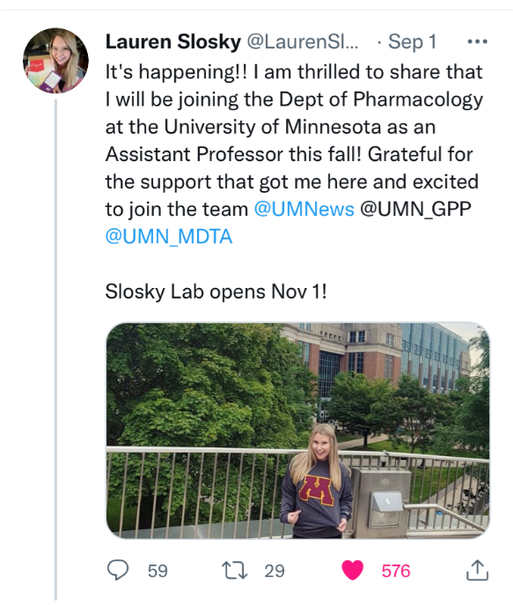
Service
Jacques Stout
Jacques.Stout@duke.edu
Notes:
Goals of the committee:
1. Give postdocs a forum to present their research to general audiences and help amplify the impact of their work.
2. Reach out to K-12 and college students and familiarize them with graduate school and a career in research by presenting our work and telling our stories.
3. Engage with our local communities and find ways to more effectively disseminate our work and collaborate for their benefit.

Slide 23
Service
Jacques Stout
Jacques.Stout@duke.edu
Upcoming Service Opportunities:
Communities in Partnership:
Vaccination event in East Durham 10/9 and 10/10 (THIS WEEKEND! Sending info to listserv after meeting)
Require around 8 people on either days
They are particularly encouraging/asking for the help of bilinguals and Black/Latinx individuals to help with canvassing these communities
The food bank needs help with packaging and sorting salvaged food on Saturday 10/16 9am to 12 pm
'Move-A-Bull City' event with Bike Durham 10/16
Looking for a co-chair!
Notes:
Goals of the committee:
1. Give postdocs a forum to present their research to general audiences and help amplify the impact of their work.
2. Reach out to K-12 and college students and familiarize them with graduate school and a career in research by presenting our work and telling our stories.
3. Engage with our local communities and find ways to more effectively disseminate our work and collaborate for their benefit.

Slide 24
Meeting Agenda
October 6, 2021
Welcome
Opening announcements
Chair updates
  Communications – Miranda Scalabrino & OPEN
  Diversity – Marhiah Montoya & OPEN
  International – Yutian Feng, Dilimini Wijesinghe, Thomas Pomberger, Atefah (Aty) Ghazavi, Weijia Su
  Outreach – Claudia Gonzalez-Hunt & Daniel Luo
  Professional Development – Susanna Brantley & Corinne Haines
  Service – Jacques Stout & OPEN
  Social – OPEN!
New council member election
Questions and Discussion
Closing

Slide 25
Social
OPEN!
Social Committee Duties:
The duties of a Social Committee include planning a variety of events that reach out to all Duke University postdocs. The Social Committee is dedicated to improving the postdoc experience by facilitating new interactions and connections for postdocs across campus. Examples of previous events include organizing intramural sports teams, postdoc pub nights, Hurricanes Hockey game group tickets, Lemur Center tours, Trivia/game nights, and more. We also have established connections with the UNC and NC State Postdoc Associations to collaboratively plan joint social events! The Social Committee is always looking for new event ideas, so if you enjoy planning events, socializing, and meeting new people, please join!
Goals of Social Committee:
Acquire 3+ individuals in order to keep up with demand for more variety in events
Offer at least 1 event per month
Notes:
Goals of the committee:
1. Give postdocs a forum to present their research to general audiences and help amplify the impact of their work.
2. Reach out to K-12 and college students and familiarize them with graduate school and a career in research by presenting our work and telling our stories.
3. Engage with our local communities and find ways to more effectively disseminate our work and collaborate for their benefit.

Slide 26
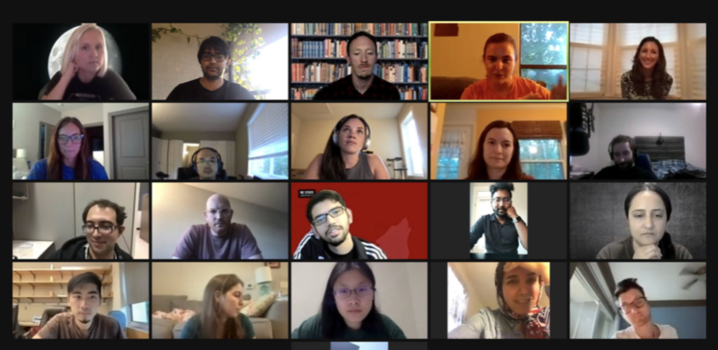
Social
OPEN!
Social Committee Updates:
National Postdoc Appreciation Week Triangle Social Virtual Event (Thurs, Sept. 23rd) – 30+ total attendees, roughly 10 from Duke
Hosted two Lemur Center Tours on Sunday, Sept. 26th which were very successful!
Notes:
Goals of the committee:
1. Give postdocs a forum to present their research to general audiences and help amplify the impact of their work.
2. Reach out to K-12 and college students and familiarize them with graduate school and a career in research by presenting our work and telling our stories.
3. Engage with our local communities and find ways to more effectively disseminate our work and collaborate for their benefit.

Slide 27
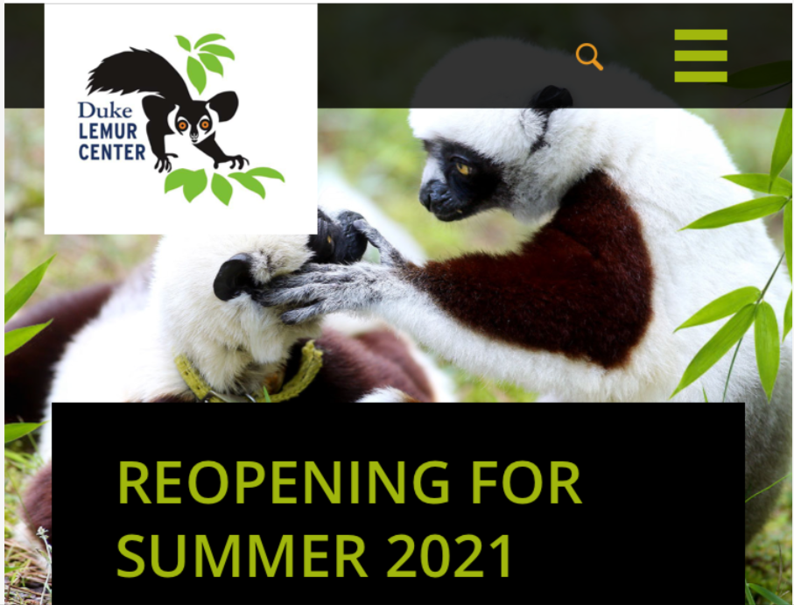
Social
OPEN!
Social Committee Updates:
National Postdoc Appreciation Week Triangle Social Virtual Event (Thurs, Sept. 23rd) – 30+ total attendees, roughly 10 from Duke
Hosted two Lemur Center Tours on Sunday, Sept. 26th which were very successful!
Notes:
Goals of the committee:
1. Give postdocs a forum to present their research to general audiences and help amplify the impact of their work.
2. Reach out to K-12 and college students and familiarize them with graduate school and a career in research by presenting our work and telling our stories.
3. Engage with our local communities and find ways to more effectively disseminate our work and collaborate for their benefit.

Slide 28
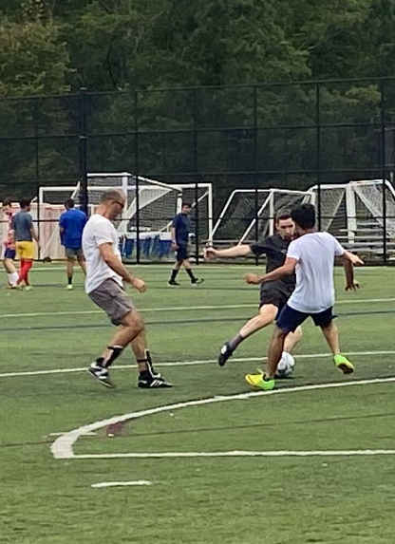
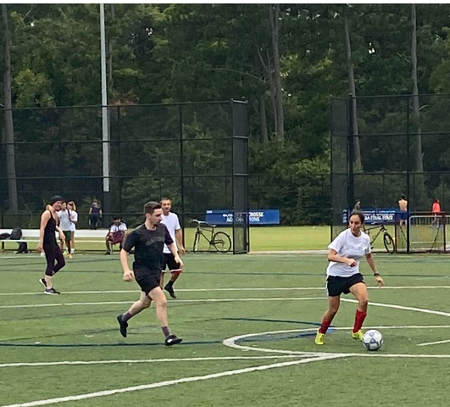
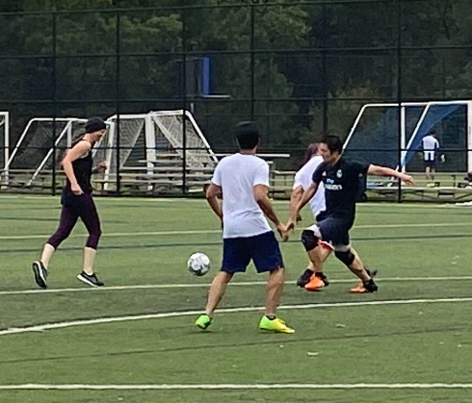
Social
OPEN!
Fall Intramural Sports teams!
Notes:
Goals of the committee:
1. Give postdocs a forum to present their research to general audiences and help amplify the impact of their work.
2. Reach out to K-12 and college students and familiarize them with graduate school and a career in research by presenting our work and telling our stories.
3. Engage with our local communities and find ways to more effectively disseminate our work and collaborate for their benefit.

Slide 29
Social
OPEN!
Ideas for Future Events:
Group rate tickets to the NC State Fair
Corn Maze/Pumpkin Patch
Food Truck/Ice Cream Truck/Coffee/Drink Truck on Campus
Cooking Class – potentially at Season to Taste
Wine and Design – Painting
Postdoc Pub Night (example venues: Bull McCabe’s, Bull City Ciderworks, and Boxcar Bar and Arcade)
Looking for new committee members!
Notes:
Goals of the committee:
1. Give postdocs a forum to present their research to general audiences and help amplify the impact of their work.
2. Reach out to K-12 and college students and familiarize them with graduate school and a career in research by presenting our work and telling our stories.
3. Engage with our local communities and find ways to more effectively disseminate our work and collaborate for their benefit.

Slide 30
Meeting Agenda
October 6, 2021
Welcome
Opening announcements
Chair updates
  Communications – Miranda Scalabrino & OPEN
  Diversity – Marhiah Montoya & OPEN
  International – Yutian Feng, Dilimini Wijesinghe, Thomas Pomberger, Atefah (Aty) Ghazavi, Weijia Su
  Outreach – Claudia Gonzalez-Hunt & Daniel Luo
  Professional Development – Susanna Brantley & Corinne Haines
  Service – Jacques Stout & OPEN
  Social – OPEN!
New council member election
Questions and Discussion
Closing

Slide 31
Meeting Agenda
October 6, 2021
Welcome
Opening announcements
Chair updates
  Communications – Miranda Scalabrino & OPEN
  Diversity – Marhiah Montoya & OPEN
  International – Yutian Feng, Dilimini Wijesinghe, Thomas Pomberger, Atefah (Aty) Ghazavi, Weijia Su
  Outreach – Claudia Gonzalez-Hunt & Daniel Luo
  Professional Development – Susanna Brantley & Corinne Haines
  Service – Jacques Stout & OPEN
  Social – OPEN!
New council member election
Questions and Discussion
Closing

Slide 32
Meeting Agenda
October 6, 2021
Welcome
Opening announcements
Chair updates
  Communications – Miranda Scalabrino & OPEN
  Diversity – Marhiah Montoya & OPEN
  International – Yutian Feng, Dilimini Wijesinghe, Thomas Pomberger, Atefah (Aty) Ghazavi, Weijia Su
  Outreach – Claudia Gonzalez-Hunt & Daniel Luo
  Professional Development – Susanna Brantley & Corinne Haines
  Service – Jacques Stout & OPEN
  Social – OPEN!
New council member election
Questions and Discussion
Closing

Slide 33
Service
Jacques Stout
Jacques.Stout@duke.edu
Mark your calendars!
Upcoming DUPA meetings:
November 3, 2021
December 1, 2021
Notes:
Goals of the committee:
1. Give postdocs a forum to present their research to general audiences and help amplify the impact of their work.
2. Reach out to K-12 and college students and familiarize them with graduate school and a career in research by presenting our work and telling our stories.
3. Engage with our local communities and find ways to more effectively disseminate our work and collaborate for their benefit.

