Slide 1

Meeting Agenda
November 3, 2021
Welcome
Opening announcements
Chair updates
  Communications – Miranda Scalabrino & OPEN
  Diversity – Marhiah Montoya & OPEN
  International – Yutian Feng, Dilimini Wijesinghe, Thomas Pomberger, Atefah (Aty) Ghazavi, Weijia Su
  Outreach – Claudia Gonzalez-Hunt, Daniel Luo, & Aty Ghazavi
  Professional Development – Susanna Brantley
  Service – Jacques Stout & OPEN
  Social – OPEN!
New council member election
Questions and Discussion
Closing

Slide 2
Meeting Agenda
November 3, 2021
Welcome
Opening announcements
Chair updates
  Communications – Miranda Scalabrino & OPEN
  Diversity – Marhiah Montoya & OPEN
  International – Yutian Feng, Dilimini Wijesinghe, Thomas Pomberger, Atefah (Aty) Ghazavi, Weijia Su
  Outreach – Claudia Gonzalez-Hunt, Daniel Luo, & Aty Ghazavi
  Professional Development – Susanna Brantley
  Service – Jacques Stout & OPEN
  Social – OPEN!
New council member election
Questions and Discussion
Closing
Notes:
Council met last week to discuss some changes we want to make to improve DUPA in order to better serve the postdoc community. Each committee defined their duties and goals. Some info sent in the monthly meeting email and is included in the slides today. We hope to recruit more postdocs from diverse backgrounds and interests, in order to best serve our community. On today’s agenda are updates from each of the committees and we can elect in new council members at the end if they’ve attended 2+ meetings. And then we will open the floor to questions and discussion. So with that, let’s jump into updates from our committee chairs!

Slide 3
Meeting Agenda
November 3, 2021
Welcome
Opening announcements
Chair updates
  Communications – Miranda Scalabrino & OPEN
  Diversity – Marhiah Montoya & OPEN
  International – Yutian Feng, Dilimini Wijesinghe, Thomas Pomberger, Atefah (Aty) Ghazavi, Weijia Su
  Outreach – Claudia Gonzalez-Hunt, Daniel Luo, & Aty Ghazavi
  Professional Development – Susanna Brantley
  Service – Jacques Stout & OPEN
  Social – OPEN!
New council member election
Questions and Discussion
Closing

Slide 4
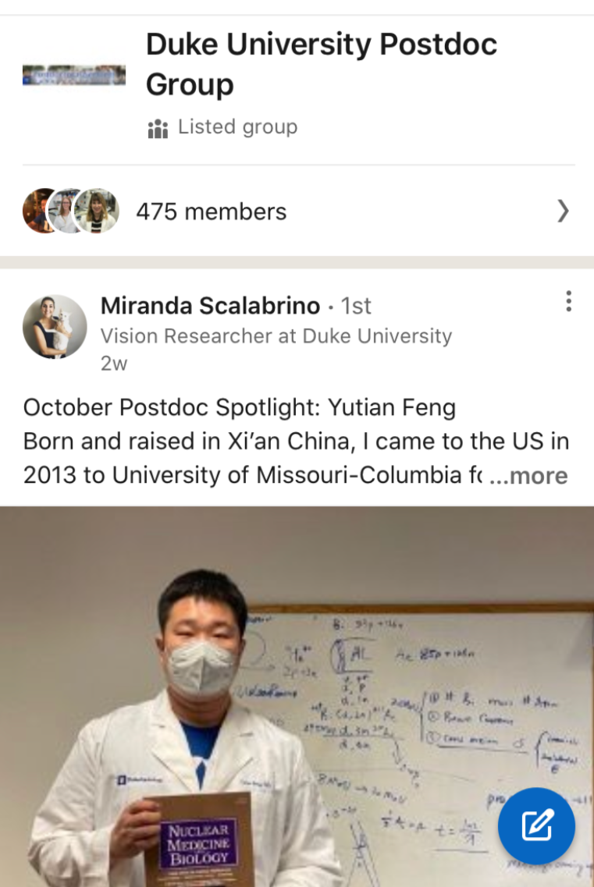
Communications
Miranda Scalabrino
Miranda.scalabrino@duke.edu
Communications Committee Duties:
The communications team is responsible for taking and distributing meeting notes, updating the website, and posting events/relevant information on Duke Postdoc social media. Goal is to spotlight 1 postdoc per month on social media. Meeting minutes should be posted & emailed to listserv within 48h of the meeting.
Updates:
We have a new DUPA LinkedIn group! Highlighting postdocs' work on this platform has gotten them attention from recruiters and industry professionals!
Looking for co-chair(s)! Nomination of Clayton Bingham.
Notes:
Goals of the committee:
1. Give postdocs a forum to present their research to general audiences and help amplify the impact of their work.
2. Reach out to K-12 and college students and familiarize them with graduate school and a career in research by presenting our work and telling our stories.
3. Engage with our local communities and find ways to more effectively disseminate our work and collaborate for their benefit.

Slide 5
Meeting Agenda
November 3, 2021
Welcome
Opening announcements
Chair updates
  Communications – Miranda Scalabrino & OPEN
  Diversity – Marhiah Montoya & OPEN
  International – Yutian Feng, Dilimini Wijesinghe, Thomas Pomberger, Atefah (Aty) Ghazavi, Weijia Su
  Outreach – Claudia Gonzalez-Hunt, Daniel Luo, & Aty Ghazavi
  Professional Development – Susanna Brantley
  Service – Jacques Stout & OPEN
  Social – OPEN!
New council member election
Questions and Discussion
Closing

Slide 6
Diversity
Marhiah Montoya
Marhiah.Montoya@duke.edu
DEI Committee Interest Meeting
Thursday, 11/4, 1-2pm - https://duke.zoom.us/j/94090739745?pwd=SWJEc1FTTVc1WmM3eGUvZzZCTUFNUT09 Meeting ID: 940 9073 9745 Passcode: 421087
Monday, 11/8, 9am-10am - https://duke.zoom.us/j/95620290704?pwd=aGpEQUV0ajJMM013d0FVTFVDNjU4dz09 Meeting ID: 956 2029 0704 Passcode: 080008
International Postdoc Welcome Packet Brainstorm Sessions
Monday, 11/8, 12pm-1pm - https://duke.zoom.us/j/98595987254?pwd=dnE3UTMzYmRiMTVOZld6ZS84cHc3UT09 Meeting ID: 985 9598 7254 Passcode: 523147
Thursday, 11/11, 5pm-6pm - https://duke.zoom.us/j/98183364937?pwd=eUtDWDRGMytwOXZvaWwvVjlvOFg0dz09 Meeting ID: 981 8336 4937 Passcode: 753086
DUPA Council meeting to discuss the DUPA DEI & Workplace Conditions Survey – Sometime during the second week of November. Please slack or email Marhiah with your availability. Johnna Frierson may be attending if her schedule allows.
Other Events
11/23 at 6pm-7pm Whine & Cheese https://duke.zoom.us/j/97088229772?pwd=dWh4QndnMUUzdkl2U21ldFdYTDk1QT09 Meeting ID: 970 8822 9772 Passcode: 773391
Whine & Cheese is a Monthly Postdoc Virtual Gathering to vent (or whine) about ANYTHING, cheese is optional.
If you’re wondering what this gathering might be like, check out this YouTube video https://www.youtube.com/watch?v=Nvhh6ciMmJU
PUSHED https://duke.zoom.us/j/94141425852?pwd=RUVZYXdiVFhlRlpnUG82OUZxNm85Zz09 Meeting ID: 941 4142 5852 Passcode: 374153
PUSHED is a Monthly Zoom Brainstorming /“Think-Tank” type meeting (every 4th Wednesday) where postdocs gather to discuss ways to integrate health disparities into their research and informally discuss their research findings that relate to health disparities.
If you’re struggling with trying to find ways to connect your research with racial and ethnic health disparities, this group is for you!
Notes:
Goals of the committee:
1. Give postdocs a forum to present their research to general audiences and help amplify the impact of their work.
2. Reach out to K-12 and college students and familiarize them with graduate school and a career in research by presenting our work and telling our stories.
3. Engage with our local communities and find ways to more effectively disseminate our work and collaborate for their benefit.

Slide 7
Meeting Agenda
November 3, 2021
Welcome
Opening announcements
Chair updates
  Communications – Miranda Scalabrino & OPEN
  Diversity – Marhiah Montoya & OPEN
  International – Yutian Feng, Dilimini Wijesinghe, Thomas Pomberger, Atefah (Aty) Ghazavi, Weijia Su
  Outreach – Claudia Gonzalez-Hunt, Daniel Luo, & Aty Ghazavi
  Professional Development – Susanna Brantley
  Service – Jacques Stout & OPEN
  Social – OPEN!
New council member election
Questions and Discussion
Closing

Slide 8
DUPA
News
Postdoc Retirement Plan
Postdoc Buddy Program
International Committee
Current Members
We need new members!

Slide 9
News
The Duke postdoc comedy club organized two comedy shows in October
The show at Big Boss Brewing Co is run, organized and hosted by Duke postdoc Bo Ma!
Yutian Feng was spotlighted by DUPA on LinkedIn:
  LinkedIn profile views went up 250%
  2 HR rep from large pharmaceutical companies contacted him
  CEO from a start up bio pharm company in his field contacted him
  In the future, we should change the wording a bit to improve it

Slide 10
Postdoc Retirement Plan
Postdoctoral Associates are eligible to participate in the Duke Faculty and Staff Retirement Plan. This plan is funded by voluntary pre-tax contributions. Duke does not provide a contribution to this plan for Postdoctoral Associates. Postdoctoral Associates are eligible to participate immediately in the plan. Plan participants are always 100% vested in their own voluntary contributions .
Since they are not Duke University employees, Postdoctoral Scholars are not eligible to participate in the Duke Faculty and Staff Retirement Plan.
If an employee with a year of service goes from an ineligible status to an eligible one, they are eligible for the University retirement contribution the first of the month following the change, unless the change occurs on the first of the month.
Vesting is based on 'Years of Service' at Duke. In general, employees hired on or after 1/1/2012 will be vested after three years of service. 'Years of Service' includes all periods of employment at Duke, whether continuous or not, including periods of employment when one is not eligible to receive Duke's contribution.

Slide 11
Postdoc Buddy Program
26 postdoc participated.
-69% liked to have a buddy
-31% volunteered to be a buddy
We need more volunteers!
Most postdocs (50%) were interested to meet weekly, 23% monthly and 7% twice per week/ bimonthly
Feedback:
-Buddy was very helpful in the initial settling process and life in USA.
-Survey participants did note receive responses after registering for a buddy/volunteer not being matched with new postdocs in the past few years.
- Buddies were both new postdocs.

Slide 12
Upcoming Projects and Events
Duke Postdocs presents: Thanksgiving special comedy showcase: "Geez, thanks Covid 🙄!" (11/27)
We would like to do an interview for a podcast to promote postdoc research at Duke. We would do one interview to try it out and do more in the future.
Fall hiking trips
Live concerts and jam sessions
International potluck

Slide 13
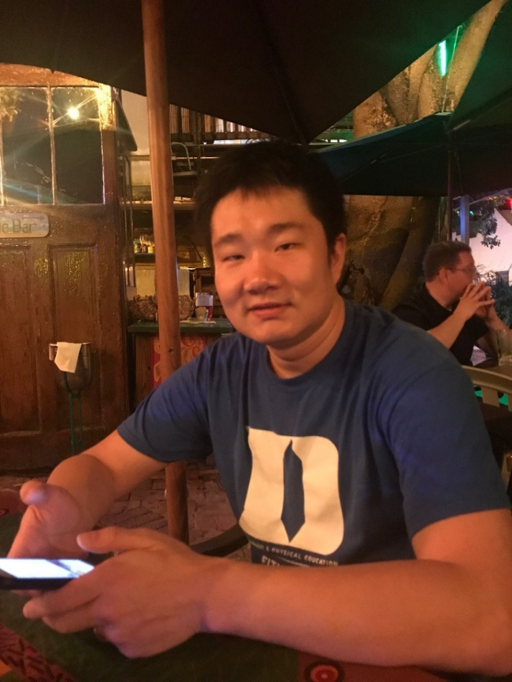
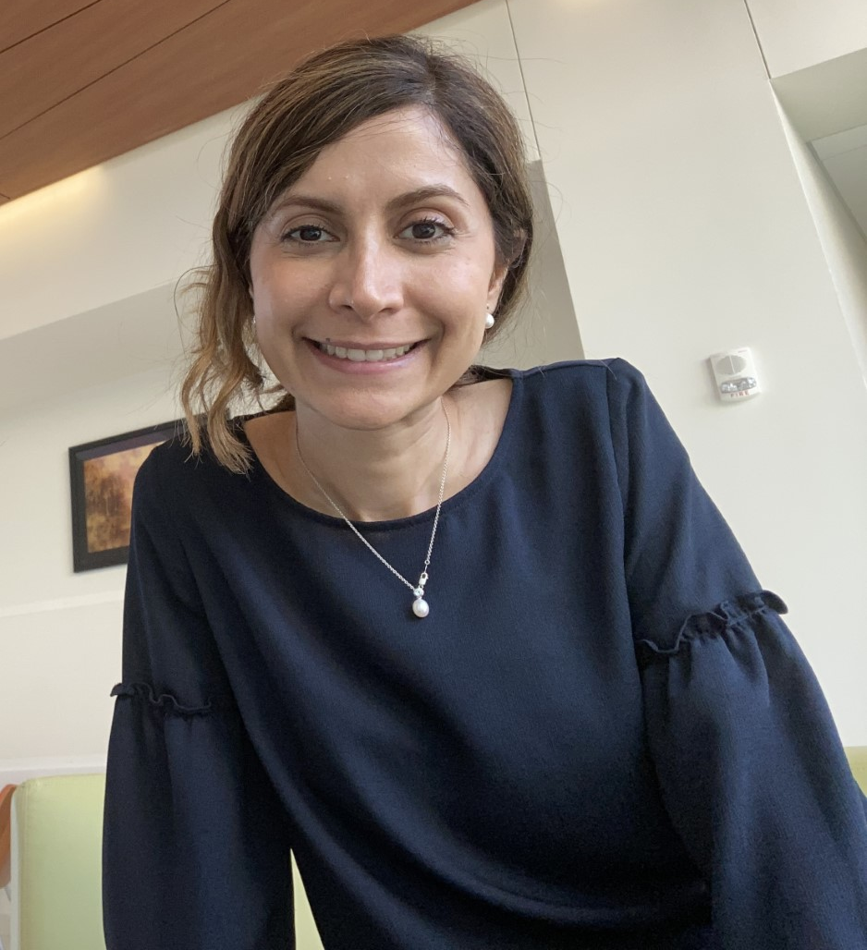
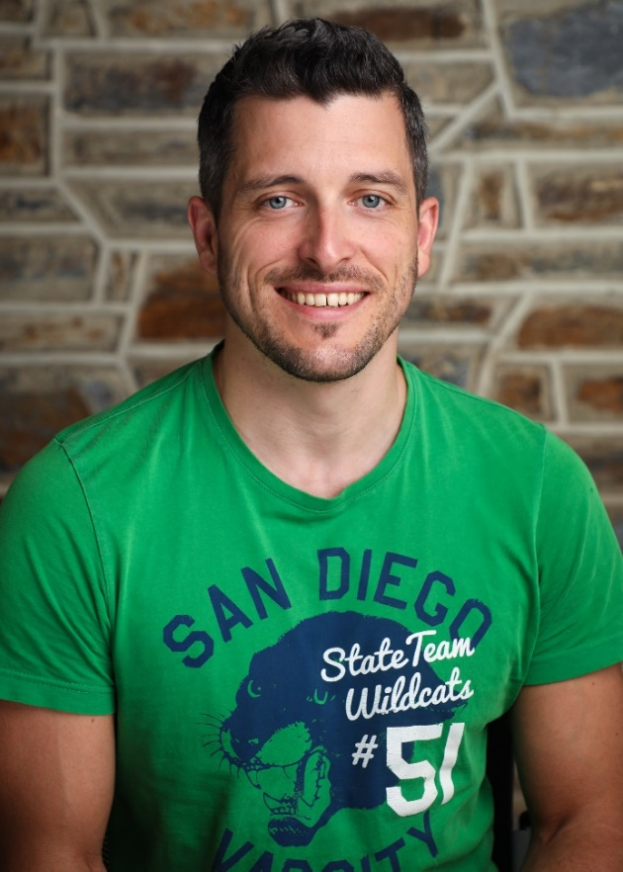
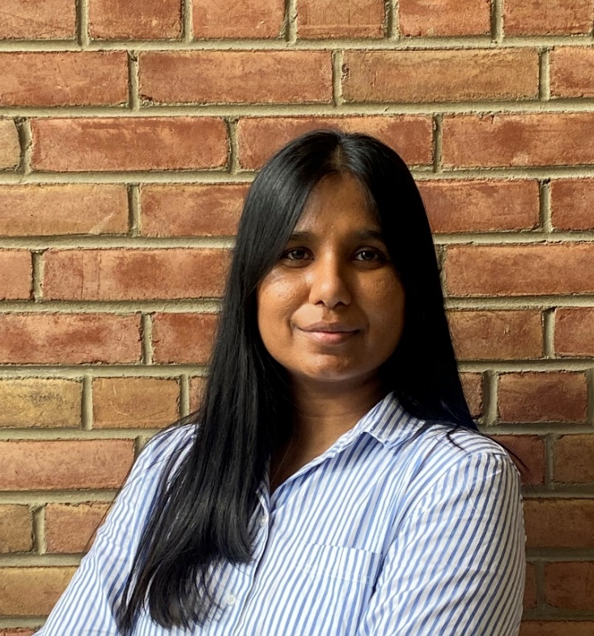
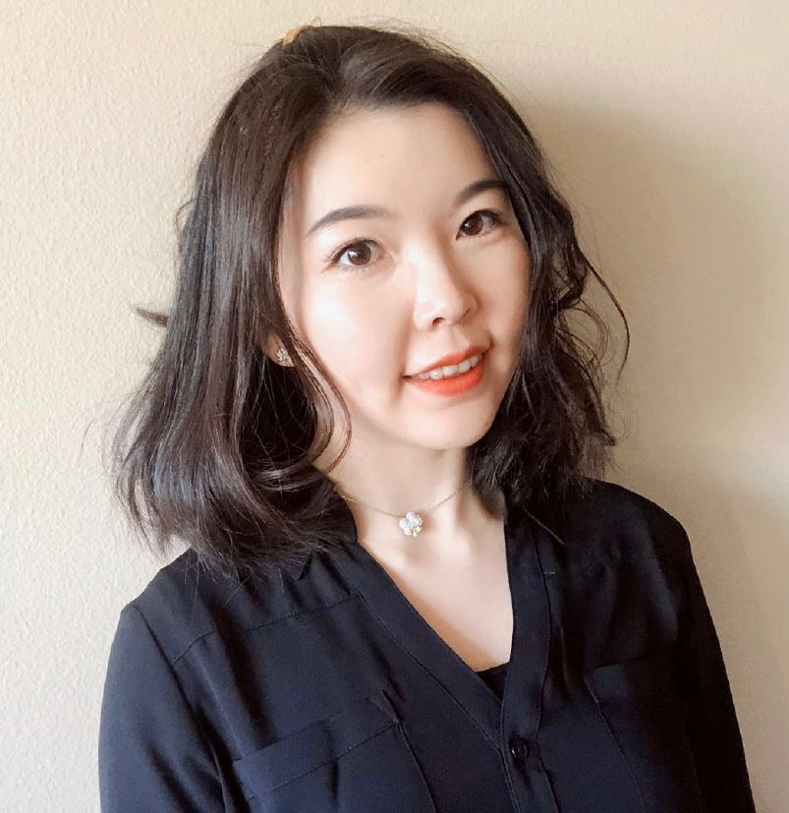
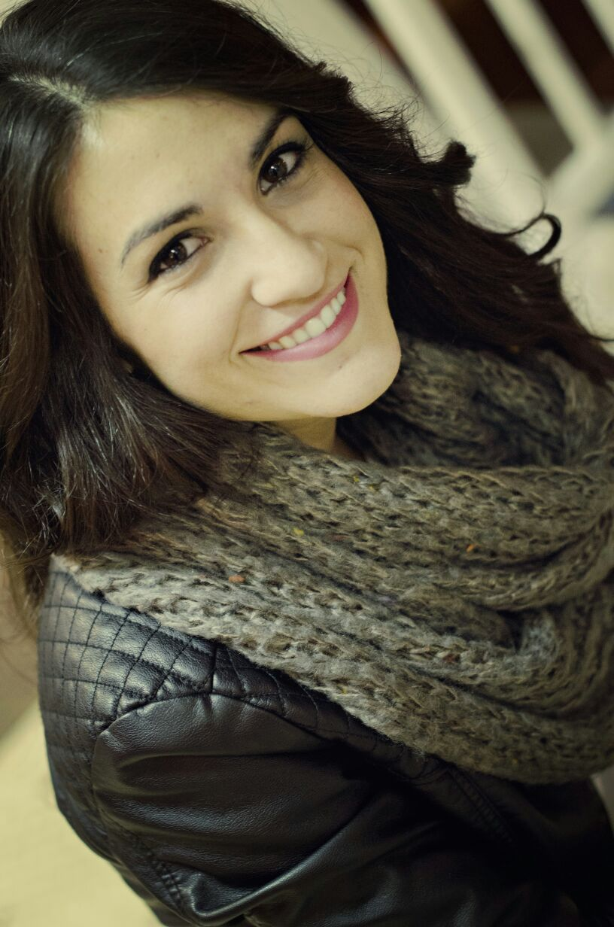
Current Members
Yutian Feng (Yutian)
yutian.feng@duke.edu
Atefeh Ghazavi (Aty)
Atefeh.ghazavi@duke.edu
Thomas Pomberger (Thomas)
thomas.pomberger@duke.edu
Dilmini Wijesinghe (Dilmini)
k.wijesinghe@duke.edu
Weijia Su (Weijia)
weijia.su@duke.edu
Belén Cortés-Llanos (Belen)
belen.cortes.llanos@duke.edu

Slide 14
We need new members!!
DUPA International Committee
Our mission: we represent and advocate for international postdocs at Duke.
What we do: we organize fun events for international postdocs and their families (potluck, picnic, game night, local tours, hiking trips, etc.), and help international postdocs navigate their life and work at Duke.
What we expect of new members: an hour or 2 per week of your free time to help us produce better events!
International postdocs make up more than half of postdocs at Duke, so we need more representations and diversity!

Slide 15
Meeting Agenda
November 3, 2021
Welcome
Opening announcements
Chair updates
  Communications – Miranda Scalabrino & OPEN
  Diversity – Marhiah Montoya & OPEN
  International – Yutian Feng, Dilimini Wijesinghe, Thomas Pomberger, Atefah (Aty) Ghazavi, Weijia Su
  Outreach – Claudia Gonzalez-Hunt, Daniel Luo, & Aty Ghazavi
  Professional Development – Susanna Brantley
  Service – Jacques Stout & OPEN
  Social – OPEN!
New council member election
Questions and Discussion
Closing

Slide 16
DUPA Outreach Committee Updates
November 3rd, 2021

Slide 17
Three Upcoming Events
  Durham Tech
  TED-style research showcase
  YouTube series

Slide 18
Durham Tech Engagement
  Present to Durham tech students our current work, our path and our experiences as an undergraduate
  Goal:
  Encouraging the students to pursue their career in science.
  Actions:
Lots of teaching/mentoring opportunities for postdocs. First up, a presentation about the "hidden curriculum" in the Spring.

Slide 19
TED-Style Research Showcase
  A one-day event, likely hybrid in-person/virtual. Postdocs do a 10-15 minute presentation about their research for a general audience. It will be open the community.
  Goal:
  Inspiring future scientists.
  Actions:
Reserved the space (Jones 153, 151 capacity) for Thursday December 2nd , 12-5 pm.
10 postdocs have expressed their interests for presenting so far.

Slide 20
YouTube Series
  We will record postdocs telling us about their research in a video format guided by some questions from us.
  Goal:
  Spreading postdocs research experiences to more people.
  Actions:
Sent out an email inviting postdocs to participate.

Slide 21
Duke-Durham School days video tour update
Goal: Make video stops for Duke tour, talking about their research. Geared towards 8th graders that would be first gen college students. Tour on Nov 5th.
Lots of postdoc participation! Six postdocs volunteered. Thank you!!

Slide 22
Meeting Agenda
November 3, 2021
Welcome
Opening announcements
Chair updates
  Communications – Miranda Scalabrino & OPEN
  Diversity – Marhiah Montoya & OPEN
  International – Yutian Feng, Dilimini Wijesinghe, Thomas Pomberger, Atefah (Aty) Ghazavi, Weijia Su
  Outreach – Claudia Gonzalez-Hunt, Daniel Luo, & Aty Ghazavi
  Professional Development – Susanna Brantley
  Service – Jacques Stout & OPEN
  Social – OPEN!
New council member election
Questions and Discussion
Closing

Slide 23
Professional Development
Susanna Brantley
Susanna.Brantley@duke.edu
Do you want to share your work with fellow postdocs and get experience giving a formal talk? Do you have a job interview coming up and want to practice your job talk with fellow postdocs?
Sign up here: https://forms.gle/uD25N2s5YKqM46pr6!
Notes:
Goals of the committee:
1. Give postdocs a forum to present their research to general audiences and help amplify the impact of their work.
2. Reach out to K-12 and college students and familiarize them with graduate school and a career in research by presenting our work and telling our stories.
3. Engage with our local communities and find ways to more effectively disseminate our work and collaborate for their benefit.

Slide 24
Professional Development
Susanna Brantley
Susanna.Brantley@duke.edu
Job Search Workshop Series:
“Navigating the Academic Job Search in Biomedical Science”
Romain Cartoni, PhD, Assistant Professor, Dept. of Pharmacology and Cancer Biology, Ophthalmology and Neurobiology
Oct 26, Nov 2, and Nov 9 from 10-11 am
Rm 143 Jones Bldg
https://duke.qualtrics.com/jfe/form/SV_81Vr4RGkdfxeJ9Q
Practice Job Talks:
Email us if you are ready to do a practice job talk. This service is a available anytime, but we will gear up in February/March of 2022
Notes:
Goals of the committee:
1. Give postdocs a forum to present their research to general audiences and help amplify the impact of their work.
2. Reach out to K-12 and college students and familiarize them with graduate school and a career in research by presenting our work and telling our stories.
3. Engage with our local communities and find ways to more effectively disseminate our work and collaborate for their benefit.

Slide 25
Meeting Agenda
November 3, 2021
Welcome
Opening announcements
Chair updates
  Communications – Miranda Scalabrino & OPEN
  Diversity – Marhiah Montoya & OPEN
  International – Yutian Feng, Dilimini Wijesinghe, Thomas Pomberger, Atefah (Aty) Ghazavi, Weijia Su
  Outreach – Claudia Gonzalez-Hunt, Daniel Luo, & Aty Ghazavi
  Professional Development – Susanna Brantley
  Service – Jacques Stout & OPEN
  Social – OPEN!
New council member election
Questions and Discussion
Closing

Slide 26
Service
Jacques Stout
Jacques.Stout@duke.edu
Upcoming Service Opportunities:
The East Durham Co-op needs volunteers to package food to help fight food insecurity in Durham on 11/18.
Looking for a co-chair!
Notes:
Goals of the committee:
1. Give postdocs a forum to present their research to general audiences and help amplify the impact of their work.
2. Reach out to K-12 and college students and familiarize them with graduate school and a career in research by presenting our work and telling our stories.
3. Engage with our local communities and find ways to more effectively disseminate our work and collaborate for their benefit.

Slide 27
Meeting Agenda
November 3, 2021
Welcome
Opening announcements
Chair updates
  Communications – Miranda Scalabrino & OPEN
  Diversity – Marhiah Montoya & OPEN
  International – Yutian Feng, Dilimini Wijesinghe, Thomas Pomberger, Atefah (Aty) Ghazavi, Weijia Su
  Outreach – Claudia Gonzalez-Hunt, Daniel Luo, & Aty Ghazavi
  Professional Development – Susanna Brantley
  Service – Jacques Stout & OPEN
  Social – OPEN!
New council member election
Questions and Discussion
Closing

Slide 28
Social
OPEN!
Social Committee Duties:
The duties of a Social Committee include planning a variety of events that reach out to all Duke University postdocs. The Social Committee is dedicated to improving the postdoc experience by facilitating new interactions and connections for postdocs across campus. Examples of previous events include organizing intramural sports teams, postdoc pub nights, Hurricanes Hockey game group tickets, Lemur Center tours, Trivia/game nights, and more. We also have established connections with the UNC and NC State Postdoc Associations to collaboratively plan joint social events! The Social Committee is always looking for new event ideas, so if you enjoy planning events, socializing, and meeting new people, please join!
Goals of Social Committee:
Acquire 3+ individuals in order to keep up with demand for more variety in events
Offer at least 1 event per month
Notes:
Goals of the committee:
1. Give postdocs a forum to present their research to general audiences and help amplify the impact of their work.
2. Reach out to K-12 and college students and familiarize them with graduate school and a career in research by presenting our work and telling our stories.
3. Engage with our local communities and find ways to more effectively disseminate our work and collaborate for their benefit.

Slide 29
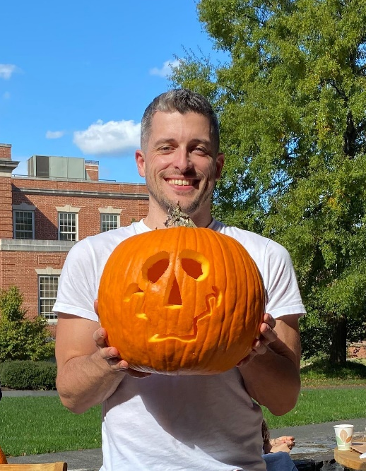
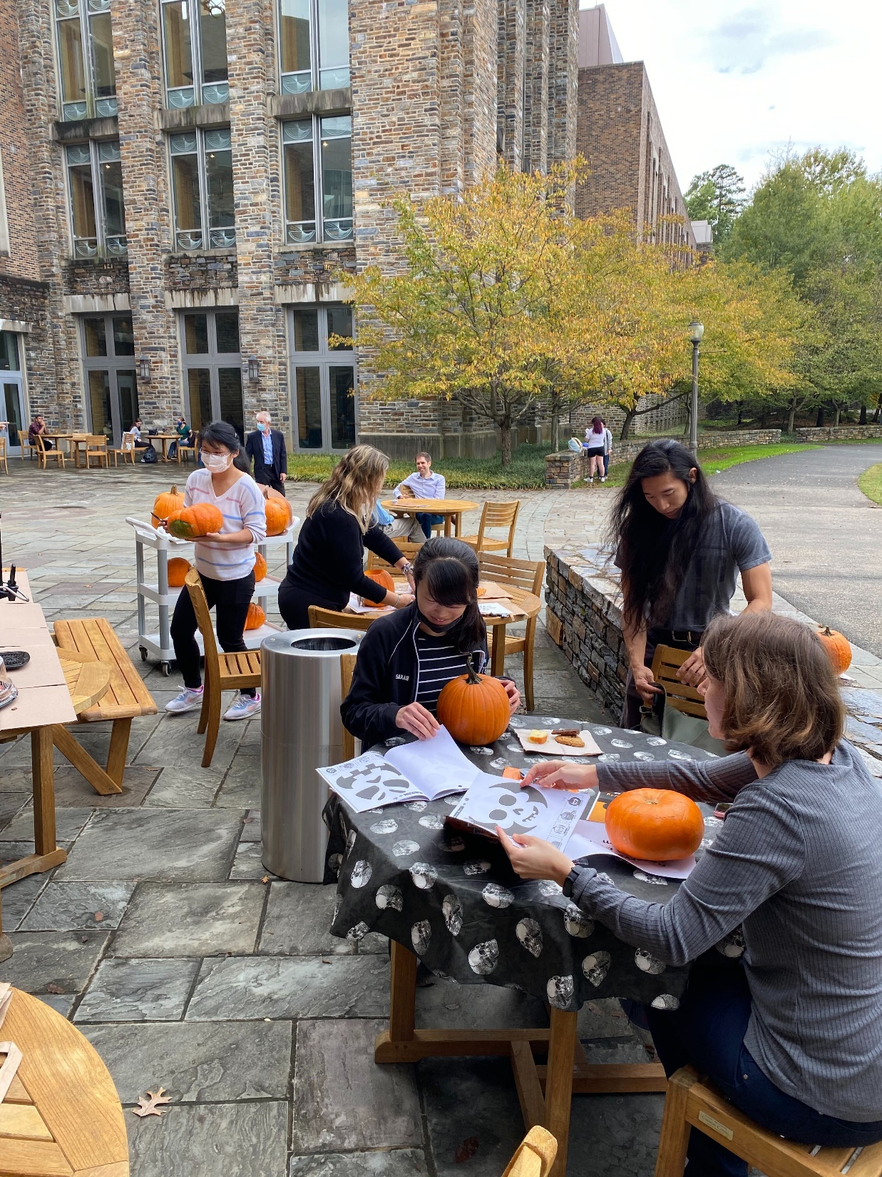
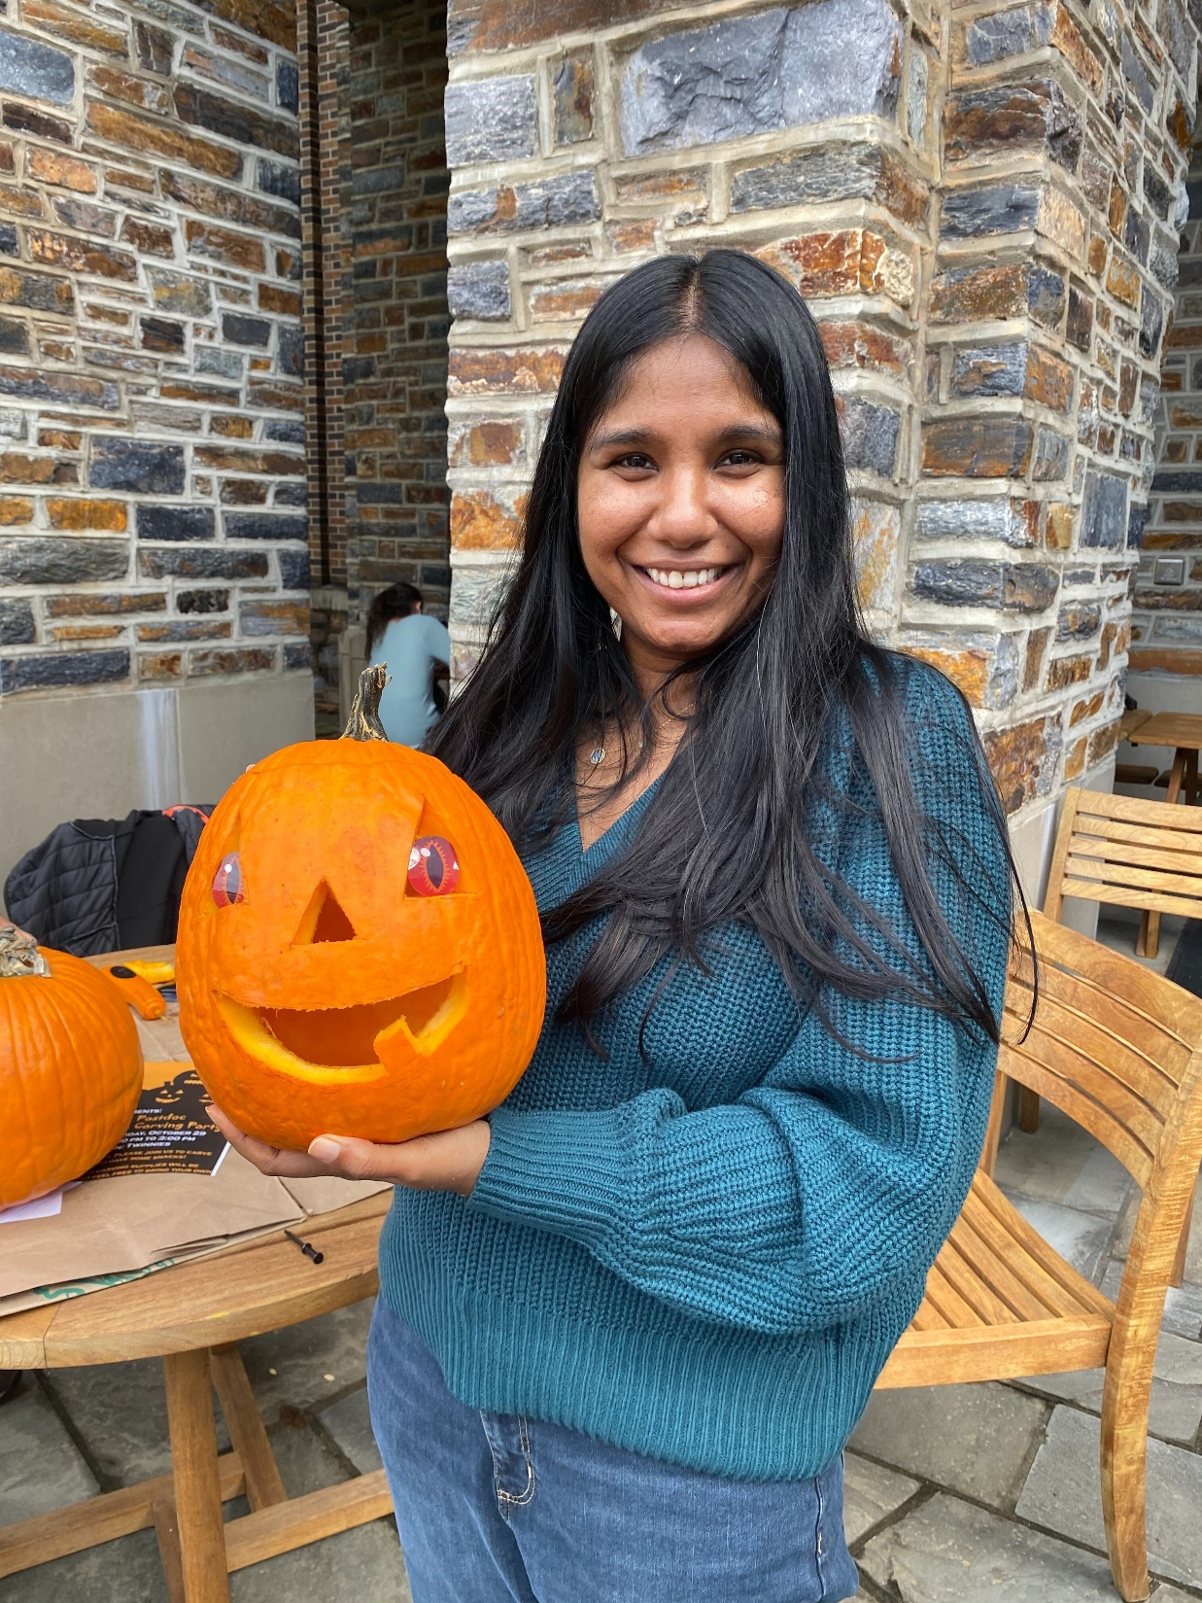
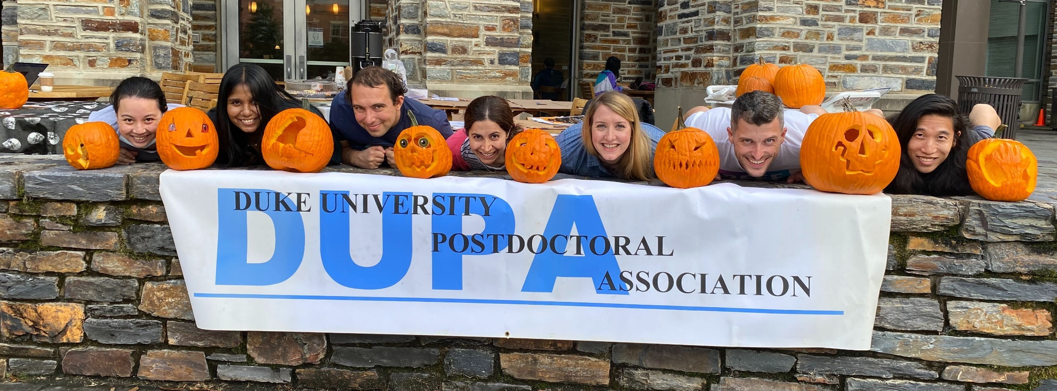
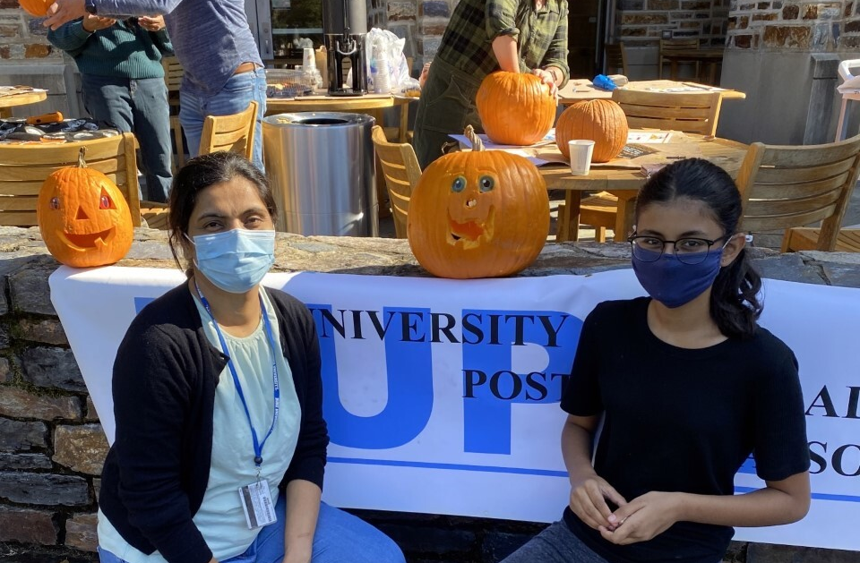
Social
OPEN!
Social Committee Updates:
Pumpkin Carving Event 10/29
Nominate new chair: Gene Yu
Notes:
Goals of the committee:
1. Give postdocs a forum to present their research to general audiences and help amplify the impact of their work.
2. Reach out to K-12 and college students and familiarize them with graduate school and a career in research by presenting our work and telling our stories.
3. Engage with our local communities and find ways to more effectively disseminate our work and collaborate for their benefit.

Slide 30
Meeting Agenda
November 3, 2021
Welcome
Opening announcements
Chair updates
  Communications – Miranda Scalabrino & OPEN
  Diversity – Marhiah Montoya & OPEN
  International – Yutian Feng, Dilimini Wijesinghe, Thomas Pomberger, Atefah (Aty) Ghazavi, Weijia Su
  Outreach – Claudia Gonzalez-Hunt, Daniel Luo, & Aty Ghazavi
  Professional Development – Susanna Brantley
  Service – Jacques Stout & OPEN
  Social – OPEN!
New council member election
Questions and Discussion
Closing

Slide 31
Meeting Agenda
November 3, 2021
Welcome
Opening announcements
Chair updates
  Communications – Miranda Scalabrino & OPEN
  Diversity – Marhiah Montoya & OPEN
  International – Yutian Feng, Dilimini Wijesinghe, Thomas Pomberger, Atefah (Aty) Ghazavi, Weijia Su
  Outreach – Claudia Gonzalez-Hunt, Daniel Luo, & Aty Ghazavi
  Professional Development – Susanna Brantley
  Service – Jacques Stout & OPEN
  Social – OPEN!
New council member election
Questions and Discussion
Closing

Slide 32
Meeting Agenda
November 3, 2021
Welcome
Opening announcements
Chair updates
  Communications – Miranda Scalabrino & OPEN
  Diversity – Marhiah Montoya & OPEN
  International – Yutian Feng, Dilimini Wijesinghe, Thomas Pomberger, Atefah (Aty) Ghazavi, Weijia Su
  Outreach – Claudia Gonzalez-Hunt, Daniel Luo, & Aty Ghazavi
  Professional Development – Susanna Brantley
  Service – Jacques Stout & OPEN
  Social – OPEN!
New council member election
Questions and Discussion
Closing

Slide 33
Service
Jacques Stout
Jacques.Stout@duke.edu
Mark your calendars!
Next DUPA meeting:
December 1, 2021
Notes:
Goals of the committee:
1. Give postdocs a forum to present their research to general audiences and help amplify the impact of their work.
2. Reach out to K-12 and college students and familiarize them with graduate school and a career in research by presenting our work and telling our stories.
3. Engage with our local communities and find ways to more effectively disseminate our work and collaborate for their benefit.

