Slide 1
Meeting Agenda
December 1, 2021
Welcome
Opening announcements
Chair updates
Communications – Miranda Scalabrino & Clayton Bingham
Diversity – Marhiah Montoya & OPEN
International – Yutian Feng, Dilimini Wijesinghe, Thomas Pomberger, Atefah (Aty) Ghazavi, Weijia Su, Belén Cortéz-Llanos
Outreach – Claudia Gonzalez-Hunt, Daniel Luo, & Aty Ghazavi
Professional Development – Susanna Brantley
Service – Jacques Stout & OPEN
Social – Gene Yu & OPEN!
New council member election
Questions and Discussion
Closing

Slide 2
Meeting Agenda
December 1, 2021
Welcome
Opening announcements
Chair updates
Communications – Miranda Scalabrino & Clayton Bingham
Diversity – Marhiah Montoya & OPEN!
International – Yutian Feng, Dilimini Wijesinghe, Thomas Pomberger, Atefah (Aty) Ghazavi, Weijia Su, Belén Cortéz-Llanos
Outreach – Claudia Gonzalez-Hunt, Daniel Luo, & Aty Ghazavi
Professional Development – Susanna Brantley
Service – Jacques Stout & OPEN!
Social – Gene Yu & OPEN!
New council member election
Questions and Discussion
Closing
Notes:
Welcome everyone! My name is Susanna Brantley, the DUPA professional development chair, and I am subbing in today for our president, Cameron Prigge, who is on a job interview. If this is your first time at a DUPA meeting, welcome, and I hope you will introduce yourself at the end of the meeting. DUPA meets the first Weds of every month, and we are always looking for new folks who want to get involved! With that, let’s get started with the chair updates.

Slide 3
Meeting Agenda
December 1, 2021
Welcome
Opening announcements
Chair updates
Communications – Miranda Scalabrino & Clayton Bingham
Diversity – Marhiah Montoya & OPEN
International – Yutian Feng, Dilimini Wijesinghe, Thomas Pomberger, Atefah (Aty) Ghazavi, Weijia Su, Belén Cortéz-Llanos
Outreach – Claudia Gonzalez-Hunt, Daniel Luo, & Aty Ghazavi
Professional Development – Susanna Brantley
Service – Jacques Stout & OPEN
Social – Gene Yu & OPEN!
New council member election
Questions and Discussion
Closing

Slide 4
Communications
Miranda Scalabrino
miranda.scalabrino@duke.edu
Clayton Bingham
clayton.bingham@duke.edu
Communications Committee Duties:
The communications team is responsible for taking and distributing meeting notes, updating the website, and posting events/relevant information on Duke Postdoc social media. Goal is to spotlight 1 postdoc per month on social media. Meeting minutes should be posted & emailed to listserv within 48h of the meeting.
Updates:
Slack Group dukepostdocs.slack.com
LinkedIn Group linkedin.com/company/80368698/
Twitter @DukePostdocs
Website dukepostdocs.org
Looking for co-chair(s)!

Slide 5
Meeting Agenda
November 3, 2021
Welcome
Opening announcements
Chair updates
Communications – Miranda Scalabrino & Clayton Bingham
Diversity – Marhiah Montoya & OPEN
International – Yutian Feng, Dilimini Wijesinghe, Thomas Pomberger, Atefah (Aty) Ghazavi, Weijia Su, Belén Cortéz-Llanos
Outreach – Claudia Gonzalez-Hunt, Daniel Luo, & Aty Ghazavi
Professional Development – Susanna Brantley
Service – Jacques Stout & OPEN
Social – Gene Yu & OPEN!
New council member election
Questions and Discussion
Closing

Slide 6
Diversity
Marhiah Montoya
Marhiah.Montoya@duke.edu
Updates:
International Postdoc Info Meetings
Postdoc Climate Survey
Looking for co-chair(s)!

Slide 7
Meeting Agenda
November 3, 2021
Welcome
Opening announcements
Chair updates
Communications – Miranda Scalabrino & Clayton Bingham
Diversity – Marhiah Montoya & OPEN
International – Yutian Feng, Dilimini Wijesinghe, Thomas Pomberger, Atefah (Aty) Ghazavi, Weijia Su, Belén Cortéz-Llanos
Outreach – Claudia Gonzalez-Hunt, Daniel Luo, & Aty Ghazavi
Professional Development – Susanna Brantley
Service – Jacques Stout & OPEN
Social – Gene Yu & OPEN!
New council member election
Questions and Discussion
Closing

Slide 8
DUPA
Hanging Rock State Park Hiking
Postdoc Interview
Upcoming Projects and Events
International Committee
Current Members
We need new members!

Slide 9
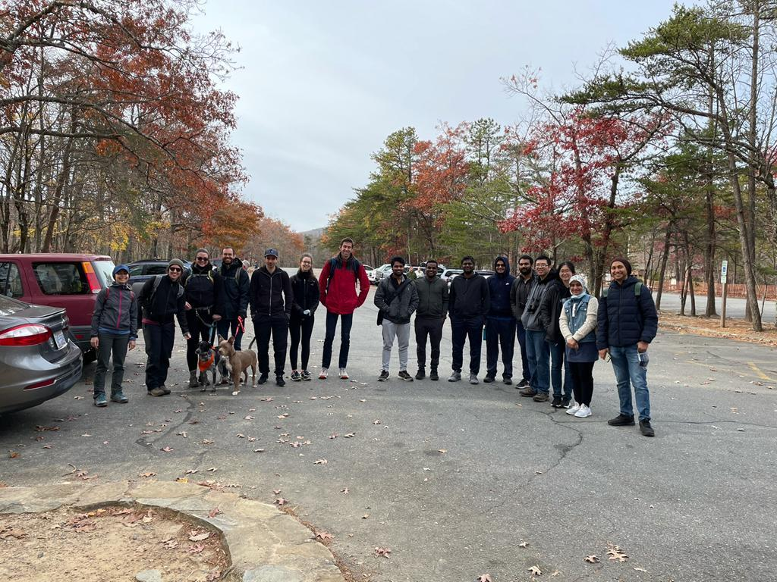
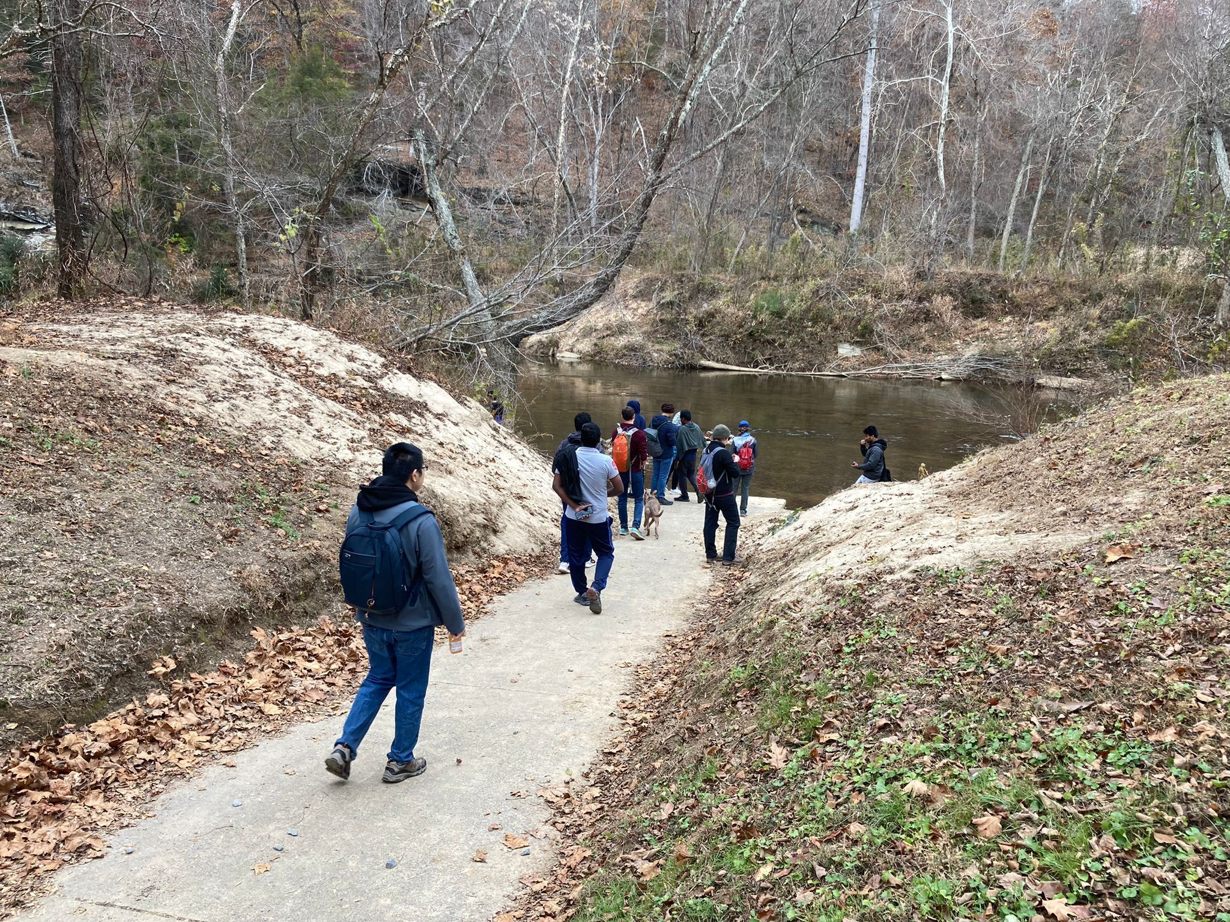
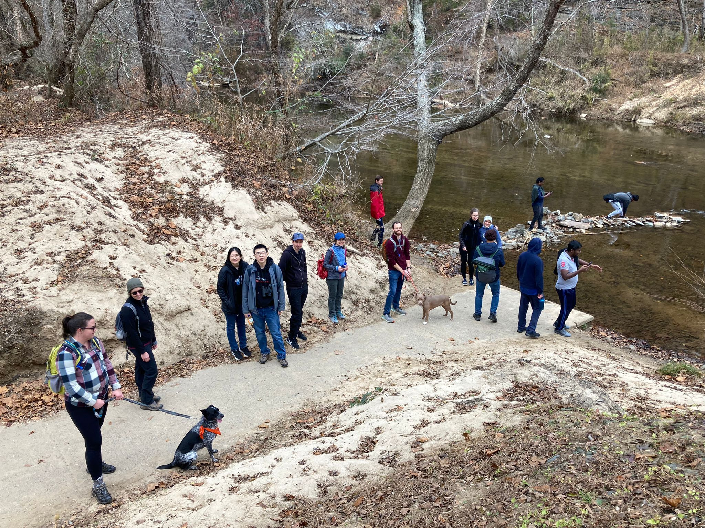
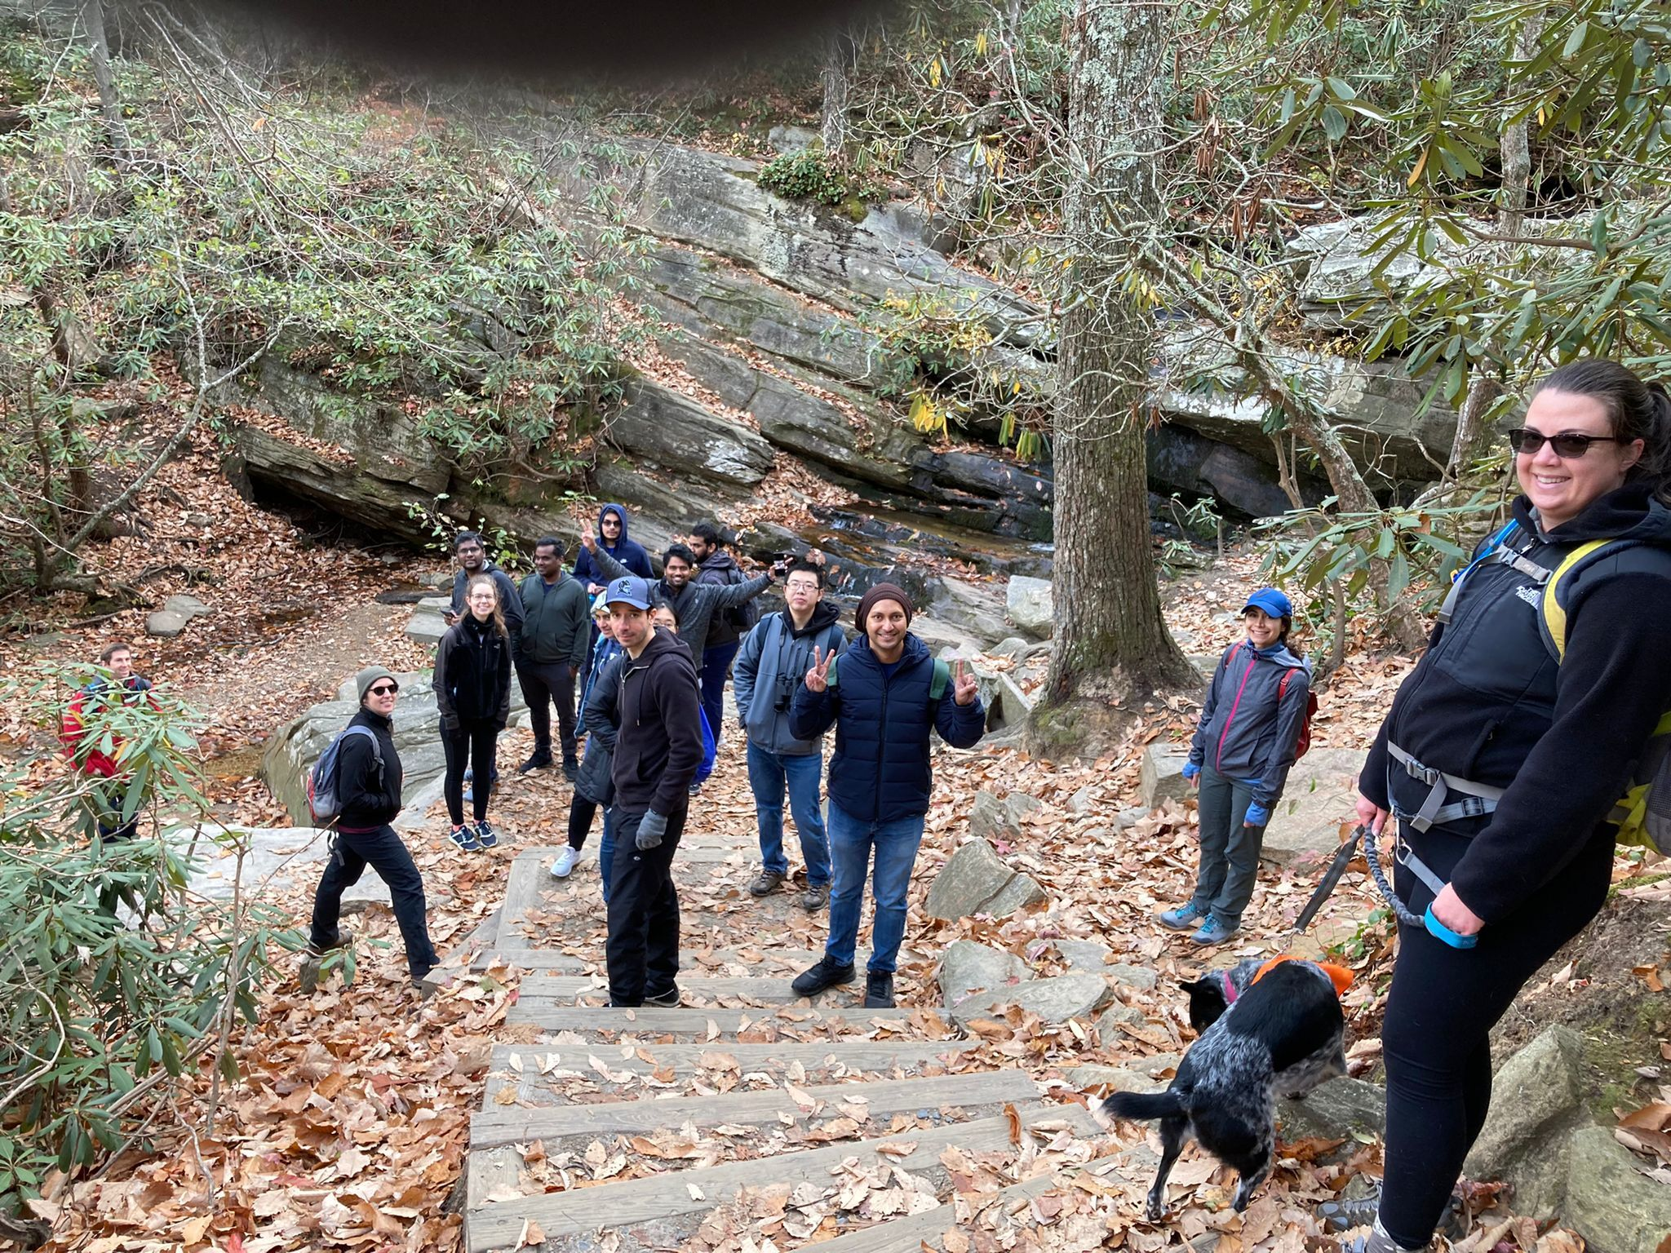
Hanging Rock State Park Hiking
Thank you Aty and Thomas

Slide 10
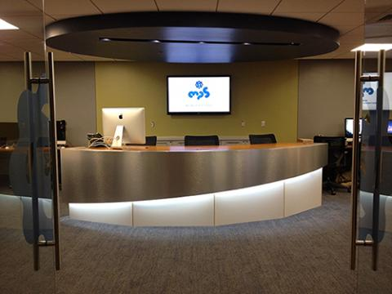
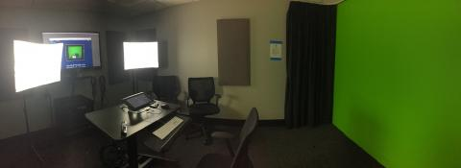
Postdoc Interview
~10 minutes interview (in person or via Zoom)
Working with Duke Multimedia Project Studio (MPS)
Current postdocs and previous postdocs
DUPA members are welcome to participate
Duke MPS

Slide 11
Upcoming Projects and Events
Duke Postdocs presents: Thanksgiving special comedy showcase: "Geez, thanks Covid 🙄!" (11/27)
Postdoc Buddy Program : Follow-up survey and re-match
Live concerts and jam sessions
International potluck

Slide 12
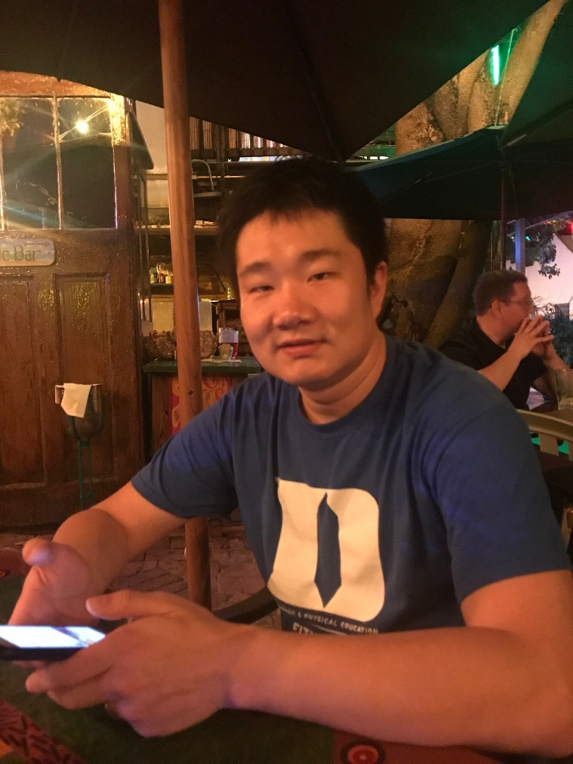
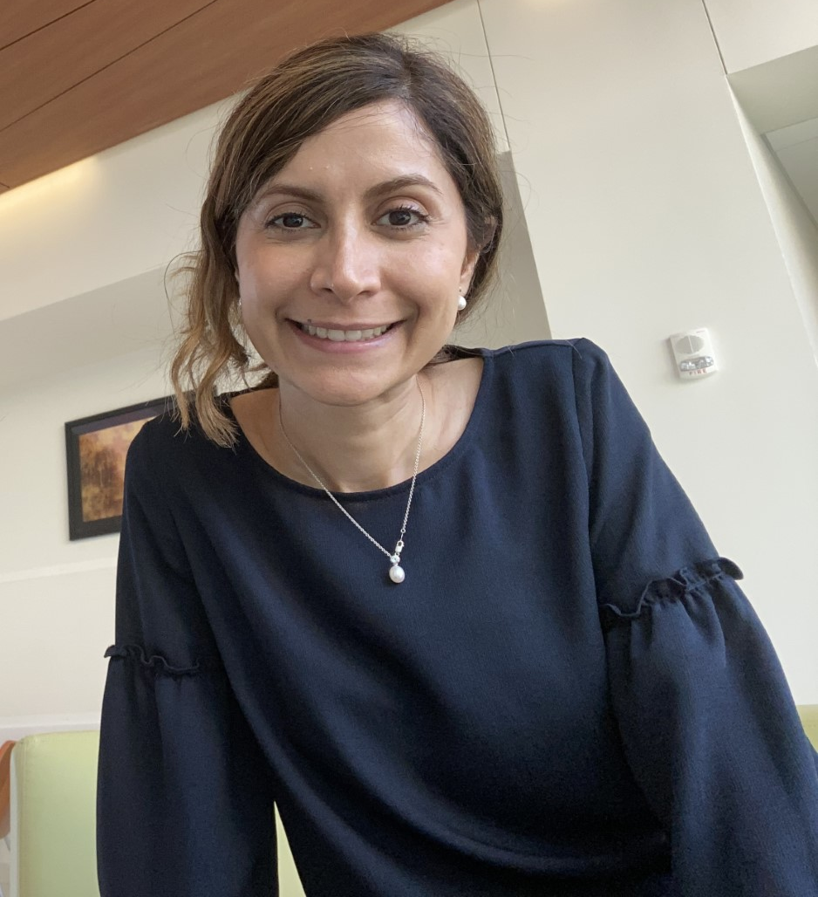
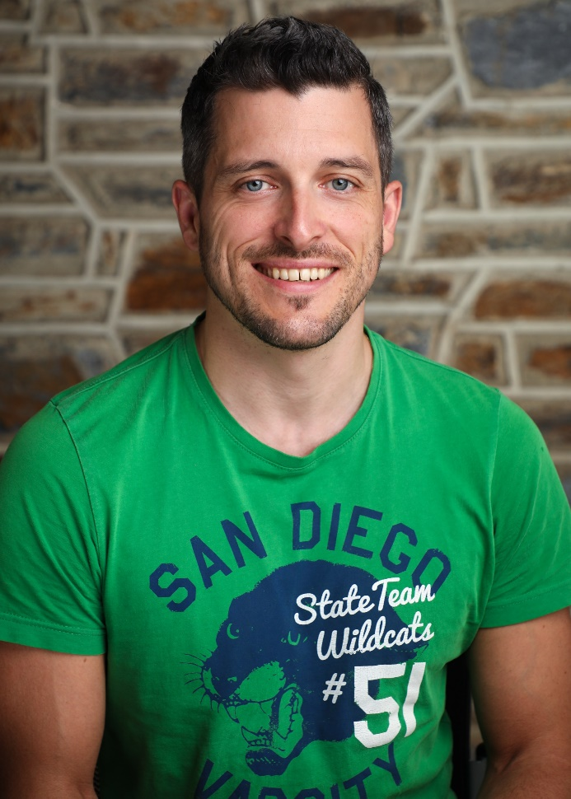
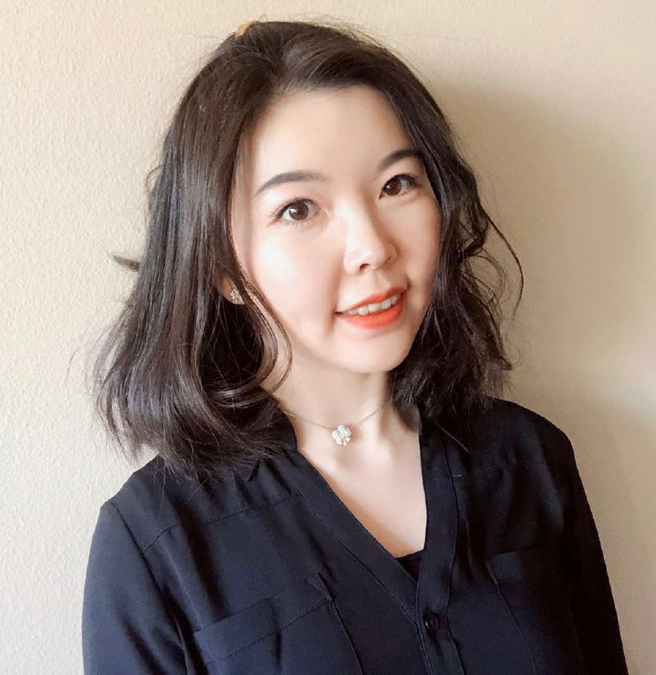
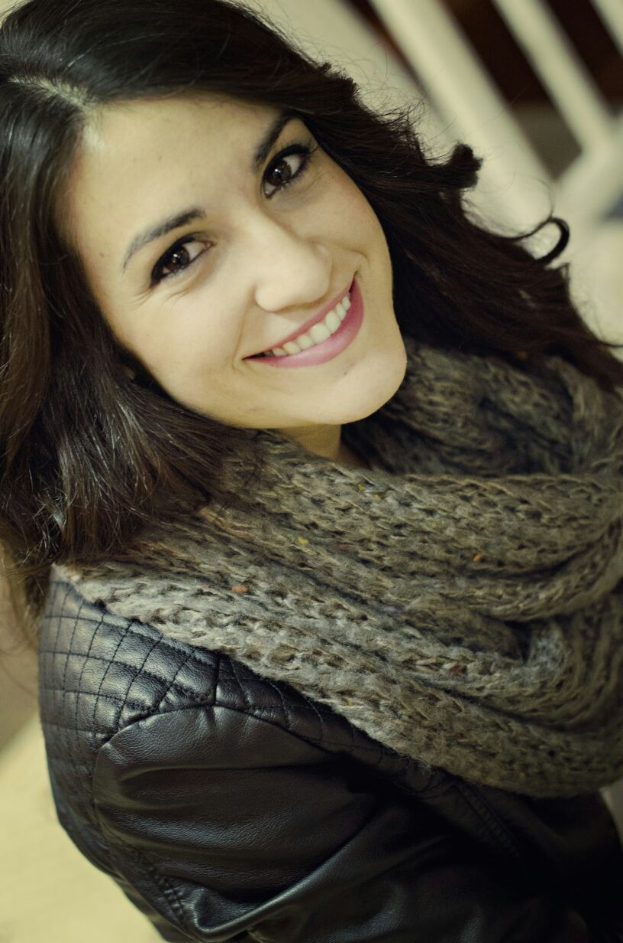
Current Members
Yutian Feng (Yutian)
yutian.feng@duke.edu
Atefeh Ghazavi (Aty)
Atefeh.ghazavi@duke.edu
Thomas Pomberger (Thomas)
thomas.pomberger@duke.edu
Dilmini Wijesinghe (Dilmini)
k.wijesinghe@duke.edu
Weijia Su (Weijia)
weijia.su@duke.edu
Belén Cortés-Llanos (Belen)
belen.cortes.llanos@duke.edu

Slide 13
We need new members!!
DUPA International Committee
Our mission: we represent and advocate for international postdocs at Duke.
What we do: we organize fun events for international postdocs and their families (potluck, picnic, game night, local tours, hiking trips, etc.), and help international postdocs navigate their life and work at Duke.
What we expect of new members: an hour or 2 per week of your free time to help us produce better events!
International postdocs make up more than half of postdocs at Duke, so we need more representations and diversity!

Slide 14
Meeting Agenda
November 3, 2021
Welcome
Opening announcements
Chair updates
Communications – Miranda Scalabrino & Clayton Bingham
Diversity – Marhiah Montoya & OPEN
International – Yutian Feng, Dilimini Wijesinghe, Thomas Pomberger, Atefah (Aty) Ghazavi, Weijia Su, Belén Cortéz-Llanos
Outreach – Claudia Gonzalez-Hunt, Daniel Luo, & Aty Ghazavi
Professional Development – Susanna Brantley
Service – Jacques Stout & OPEN
Social – Gene Yu & OPEN!
New council member election
Questions and Discussion
Closing

Slide 15
Upcoming Events
TED-style research showcase – “Postdoc Research Soapbox 2021”
Durham Tech “Hidden Curriculum” workshop

Slide 16
Postdoc Research Soapbox 2021
This Thursday! Dec 2nd 12pm Jones 143. Postdocs do a 10–15-minute TED-style presentation about their research for a general audience. Open to all! Hybrid virtual and in person. Refreshments to follow https://duke.qualtrics.com/jfe/form/SV_29uhzVe9cRS2nDo
Speaker list:
Elchanan Solomon: "Are Machines Visual Learners? The Mathematics of Perception“
Stacey Robinson: @slrobincyte (twitter) "Your Brain on Binge: How Alcohol Changes Stress and Anxiety“
Elizabeth Hughes: @eliz_bear (twitter) "Using a mucus-loving microbe to improve cancer treatment“
Daniel Wieczynski: @danwieczynski (twitter) "Climate change under the microscope“
Juhi Samal: @JuhiSamal (twitter) “Sweet crosstalk in the brain: A peek into brain's sugary secrets”
Matthew Tillman: “Love your enemies: finding therapeutics in your gut microbiome” (edited)

Slide 17
Durham Tech Event: “The Hidden Curriculum”
First week of February 2022 (tentative), likely in person
Present to Durham Tech students about all the things no one tells you about regarding undergraduate research, getting into grad school, etc.
Looking for panelists/presenters/organizers
Interested? Contact claudia.gonzalez@duke.edu, Briana.simms@duke.edu

Slide 18
Meeting Agenda
November 3, 2021
Welcome
Opening announcements
Chair updates
Communications – Miranda Scalabrino & Clayton Bingham
Diversity – Marhiah Montoya & OPEN
International – Yutian Feng, Dilimini Wijesinghe, Thomas Pomberger, Atefah (Aty) Ghazavi, Weijia Su, Belén Cortéz-Llanos
Outreach – Claudia Gonzalez-Hunt, Daniel Luo, & Aty Ghazavi
Professional Development – Susanna Brantley
Service – Jacques Stout & OPEN
Social – Gene Yu & OPEN!
New council member election
Questions and Discussion
Closing

Slide 19
Professional Development
Susanna Brantley Susanna.Brantley@duke.edu
Practice Job Talks + Postdoc Seminar Series
Sign up here: https://forms.gle/uD25N2s5YKqM46pr6
Academic Job Search Series - Leadership and Management in the Lab WHEN: Tues Dec 7, 11 am - 12 pm REGISTER: https://duke.qualtrics.com/jfe/form/SV_08k6eZWWL9LMpzE

Slide 20
Meeting Agenda
November 3, 2021
Welcome
Opening announcements
Chair updates
Communications – Miranda Scalabrino & Clayton Bingham
Diversity – Marhiah Montoya & OPEN
International – Yutian Feng, Dilimini Wijesinghe, Thomas Pomberger, Atefah (Aty) Ghazavi, Weijia Su, Belén Cortéz-Llanos
Outreach – Claudia Gonzalez-Hunt, Daniel Luo, & Aty Ghazavi
Professional Development – Susanna Brantley
Service – Jacques Stout & OPEN
Social – Gene Yu & OPEN!
New council member election
Questions and Discussion
Closing

Slide 21
Service
Jacques Stout
Jacques.Stout@duke.edu
Upcoming Service Opportunities:
Aids prevention and Awareness in Raleigh 12/4
Garden Clean-up in Hillsborough 12/11
Food Sorting in Durham 12/16.
Looking for a co-chair!

Slide 22
Meeting Agenda
November 3, 2021
Welcome
Opening announcements
Chair updates
Communications – Miranda Scalabrino & Clayton Bingham
Diversity – Marhiah Montoya & OPEN
International – Yutian Feng, Dilimini Wijesinghe, Thomas Pomberger, Atefah (Aty) Ghazavi, Weijia Su, Belén Cortéz-Llanos
Outreach – Claudia Gonzalez-Hunt, Daniel Luo, & Aty Ghazavi
Professional Development – Susanna Brantley
Service – Jacques Stout & OPEN
Social – Gene Yu & OPEN!
New council member election
Questions and Discussion
Closing

Slide 23
Social
Gene Yu
gene.yu@duke.edu
Co-chair positions available!
Social Committee Duties:
The duties of a Social Committee include planning a variety of events that reach out to all Duke University postdocs. The Social Committee is dedicated to improving the postdoc experience by facilitating new interactions and connections for postdocs across campus. Examples of previous events include organizing intramural sports teams, postdoc pub nights, Hurricanes Hockey game group tickets, Lemur Center tours, Trivia/game nights, and more. We also have established connections with the UNC and NC State Postdoc Associations to collaboratively plan joint social events! The Social Committee is always looking for new event ideas, so if you enjoy planning events, socializing, and meeting new people, please join!
Goals of Social Committee:
Acquire 3+ individuals in order to keep up with demand for more variety in events
Offer at least 1 event per month

Slide 24
Social
Gene Yu
gene.yu@duke.edu
Upcoming Attraction: Pub Night (Friday, 12/10)
An email with the registration link will be sent out very soon.
https://www.eventbrite.com/e/postdoc-pub-night-tickets-211894731847

Slide 25
Meeting Agenda
November 3, 2021
Welcome
Opening announcements
Chair updates
Communications – Miranda Scalabrino & Clayton Bingham
Diversity – Marhiah Montoya & OPEN!
International – Yutian Feng, Dilimini Wijesinghe, Thomas Pomberger, Atefah (Aty) Ghazavi, Weijia Su, Belén Cortéz-Llanos
Outreach – Claudia Gonzalez-Hunt, Daniel Luo, & Aty Ghazavi
Professional Development – Susanna Brantley
Service – Jacques Stout & OPEN!
Social – Gene Yu & OPEN!
New council member election - Juhi Samal and Briana Simms (Outreach)
Questions and Discussion
Closing

Slide 26
Meeting Agenda
November 3, 2021
Welcome
Opening announcements
Chair updates
Communications – Miranda Scalabrino & Clayton Bingham
Diversity – Marhiah Montoya & OPEN
International – Yutian Feng, Dilimini Wijesinghe, Thomas Pomberger, Atefah (Aty) Ghazavi, Weijia Su, Belén Cortéz-Llanos
Outreach – Claudia Gonzalez-Hunt, Daniel Luo, & Aty Ghazavi
Professional Development – Susanna Brantley
Service – Jacques Stout & OPEN
Social – Gene Yu & OPEN!
New council member election
Questions and Discussion
Closing

Slide 27
Meeting Agenda
November 3, 2021
Welcome
Opening announcements
Chair updates
Communications – Miranda Scalabrino & Clayton Bingham
Diversity – Marhiah Montoya & OPEN
International – Yutian Feng, Dilimini Wijesinghe, Thomas Pomberger, Atefah (Aty) Ghazavi, Weijia Su, Belén Cortéz-Llanos
Outreach – Claudia Gonzalez-Hunt, Daniel Luo, & Aty Ghazavi
Professional Development – Susanna Brantley
Service – Jacques Stout & OPEN
Social – Gene Yu & OPEN!
New council member election
Questions and Discussion
Closing

Slide 28
Mark your calendars!
Next DUPA meeting:
January 5, 2022

